Slide 1
RMSE の波数解像度依存性
 | planetary radiation |  |  |  | solar radiation
Δk cm⁻¹ | upflx W m-2 | dnflx W m-2 | flxcnv W m-3 | tend K s-1 | upflx W m-2 | dnflx W m-2 | flxcnv W m-3 | tend K s-1
50 | 3.75 | 2.84 | 3.74e-4 | 4.56e-5 | 6.80e-1 | 6.93e-1 | 4.60e-5 | 1.70e-4
20 | 6.29e-1 | 1.16 | 1.88e-4 | 6.68e-5 | 9.38e-1 | 7.42e-1 | 4.45e-5 | 2.52e-4
10 | 7.37e-1 | 6.70e-1 | 1.45e-4 | 8.95e-4 | 3.10e-1 | 4.60e-1 | 3.68e-5 | 7.28e-5
5 | 7.34e-1 | 4.42e-1 | 1.09e-4 | 2.07e-4 | 2.69e-1 | 1.74e-1 | 2.12e-5 | 3.66e-5
2 | 2.81e-1 | 2.68e-1 | 5.25e-5 | 7.64e-5 | 9.52e-2 | 1.59e-1 | 1.64e-5 | 3.12e-5
1 | 1.62e-1 | 1.99e-1 | 3.25e-5 | 2.45e-5 | 2.63e-2 | 6.24e-2 | 4.94e-6 | 1.28e-5
0.5 | 4.04e-2 | 8.69e-2 | 1.93e-5 | 3.06e-5 | 9.02e-2 | 9.83e-2 | 4.30e-6 | 5.02e-5
0.2 | 4.96e-2 | 6.91e-2 | 1.04e-5 | 2.44e-5 | 1.36e-2 | 2.97e-2 | 2.58e-6 | 9.66e-6
0.1 | 2.69e-2 | 2.81e-2 | 4.59e-6 | 1.44e-5 | 3.44e-3 | 2.61e-2 | 2.09e-6 | 1.24e-5
2+20* | 2.80e-1 | 2.68e-1 | 5.25e-5 | 7.64e-5 | 3.87e-1 | 4.19e-1 | 1.75e-5 | 3.21e-5
1+10* | 1.63e-1 | 1.98e-1 | 3.25e-5 | 2.45e-5 | 2.36e-1 | 2.19e-1 | 8.64e-6 | 1.00e-5
0.5+5* | 4.05e-2 | 8.68e-2 | 1.93e-5 | 3.06e-5 | 7.05e-2 | 7.31e-2 | 5.07e-6 | 4.57e-5
*解像度
切り替え
は 7700 cm⁻¹.

Slide 2
RMSE の波数解像度依存性 (雲なし)
 | planetary radiation |  |  |  | solar radiation
Δk cm⁻¹ | upflx W m-2 | dnflx W m-2 | flxcnv W m-3 | tend K s-1 | upflx W m-2 | dnflx W m-2 | flxcnv W m-3 | tend K s-1
50 | 1.44e1 | 6.05 | 9.80e-4 | 4.56e-5 | 3.01e-1 | 1.36 | 1.18e-4 | 1.70e-4
20 | 7.25 | 3.68 | 6.82e-4 | 6.68e-5 | 8.19e-1 | 1.08 | 6.98e-5 | 2.52e-4
10 | 5.70 | 3.88 | 4.86e-4 | 8.95e-4 | 2.98e-1 | 1.12 | 5.48e-5 | 7.28e-5
5 | 2.77 | 2.43 | 4.14e-4 | 2.07e-4 | 3.22e-2 | 6.65e-1 | 5.36e-5 | 3.67e-5
2 | 3.63 | 1.27 | 1.83e-4 | 7.64e-5 | 8.08e-2 | 4.88e-1 | 4.04e-5 | 3.12e-5
1 | 2.81 | 1.37 | 1.65e-4 | 2.45e-5 | 1.19e-2 | 7.16e-2 | 9.62e-6 | 1.28e-5
0.5 | 2.94e-1 | 2.82e-1 | 6.18e-5 | 3.05e-5 | 2.41e-2 | 1.56e-1 | 8.62e-6 | 5.02e-5
0.2 | 3.36e-1 | 2.05e-1 | 3.09e-5 | 2.44e-5 | 1.55e-3 | 3.29e-2 | 3.17e-6 | 9.66e-6
0.1 | 2.79e-2 | 3.12e-2 | 4.94e-6 | 1.44e-5 | 1.05e-3 | 2.86e-2 | 2.91e-6 | 1.24e-5
2+20* | 3.63 | 1.27 | 1.83e-4 | 7.64e-5 | 7.98e-1 | 5.12e-1 | 3.22e-5 | 3.20e-5
1+10* | 2.81 | 1.37 | 1.65e-4 | 2.45e-5 | 3.02e-1 | 4.88e-1 | 1.76e-5 | 1.00e-5
0.5+5* | 2.94e-1 | 2.82e-1 | 6.18e-5 | 3.05e-5 | 3.18e-2 | 1.92e-1 | 1.59e-5 | 4.57e-5
*解像度
切り替え
は 7700 cm⁻¹.

Slide 3
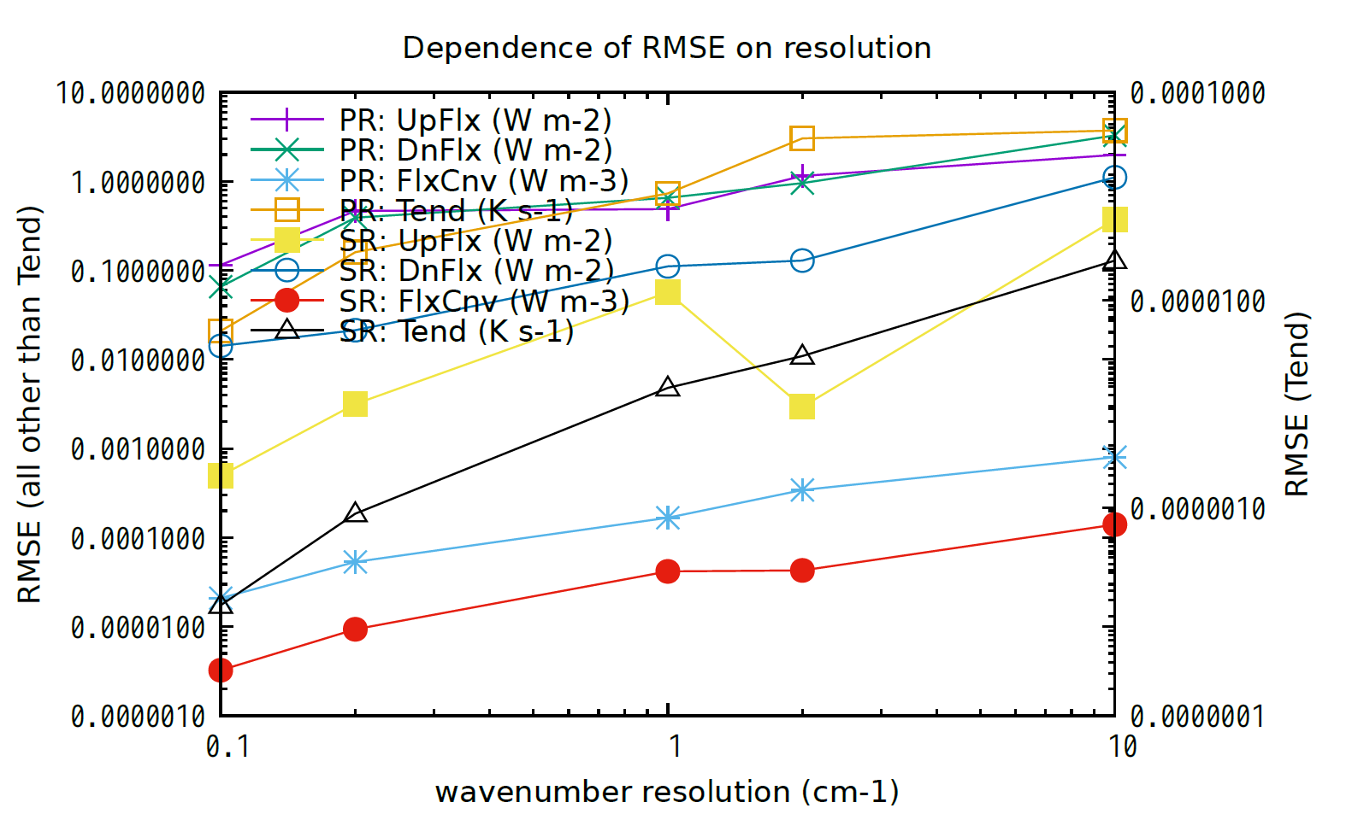
OLD

Slide 4
RMSE の波数解像度依存性
OLD
圧力範囲 p ≥ 10 hPa
Δk cm⁻¹ | upflx W m-2 | dnflx W m-2 | flxcnv W m-3 | tend K s-1 | upflx W m-2 | dnflx W m-2 | flxcnv W m-3 | tend K s-1
10 | 1.39 | 3.26 | 8.81e-4 | 5.30e-6 | 3.72e-1 | 1.23 | 1.55e-4 | 3.61e-7
2 | 1.01 | 1.04 | 3.79e-4 | 1.51e-6 | 3.13e-3 | 1.43e-1 | 4.75e-5 | 1.39e-7
1 | 5.09e-1 | 7.07e-1 | 1.84e-4 | 7.03e-7 | 5.67e-2 | 1.22e-1 | 4.62e-5 | 8.76e-8
0.2 | 3.85e-1 | 4.30e-1 | 5.87e-5 | 2.88e-7 | 3.05e-3 | 2.35e-2 | 1.04e-5 | 1.98e-8
0.1 | 1.15e-1 | 4.91e-2 | 2.14e-5 | 8.01e-8 | 4.73e-4 | 1.52e-2 | 3.59e-6 | 1.14e-8
0.1+1 *4000 cm⁻¹ | 1.15e-1 | 4.91e-2 | 2.14e-5 | 8.01e-8 | 6.01e-3 | 8.39e-2 | 2.24e-5 | 5.57e-8
0.1+1 *3500 cm⁻¹ | 1.15e-1 | 4.91e-2 | 2.14e-5 | 8.01e-8 | 6.01e-3 | 1.04e-1 | 2.38e-5 | 5.70e-8
*解像度切り替え波数.

Slide 5
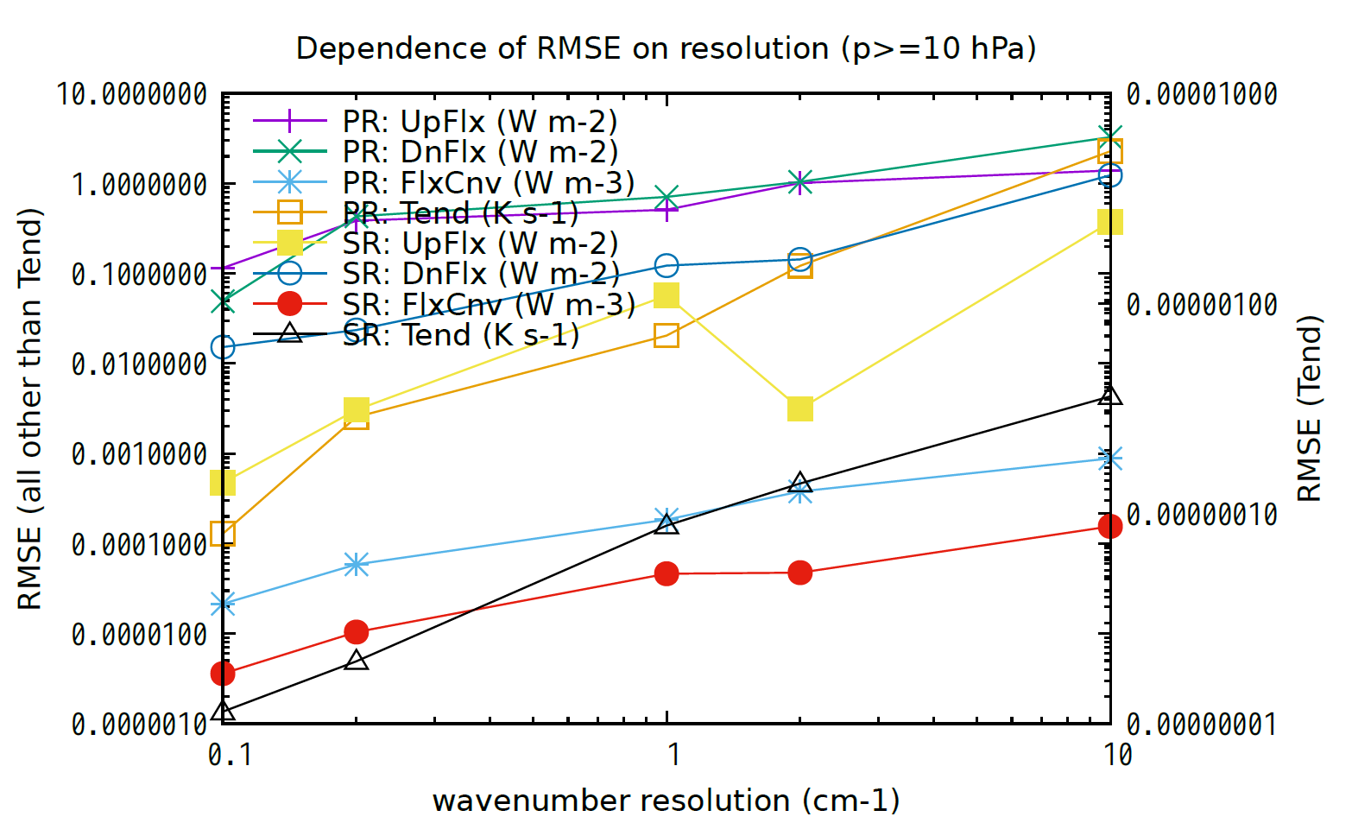
OLD

