Slide 1
格子刻み

Slide 2
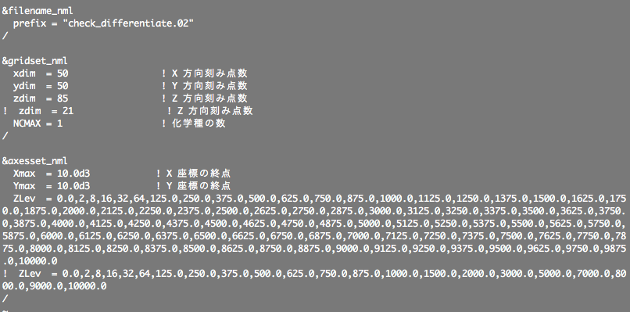
設定ファイル
Zlev に格子の位置を指定する

Slide 3

微分操作 (二次精度)
a

Slide 4
初期値/解析値
初期値
xyz_VarZ(i,j,k) = cos(z_z(k) * circ / (zmax - zmin) )
xyr_VarZ(i,j,k) = cos(r_z(k) * circ / (zmax - zmin) )
解析値
xyz_DVarZDZ0(i,j,k) = & & - sin(z_z(k) * circ / (zmax - zmin) ) * ( circ / (zmax - zmin) )
xyr_DVarZDZ0(i,j,k) = & & - sin(r_z(k) * circ / (zmax - zmin) ) * ( circ / (zmax - zmin) )

Slide 5
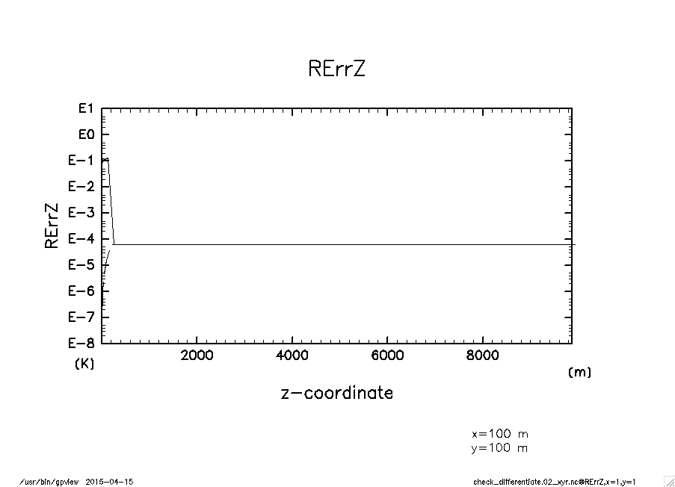
相対誤差
実線: (xyr_dz_xyz( xyz_VarZ ) – 解析値) / 解析値
破線：(xyz_dz_xyr( xyr_VarZ ) – 解析値) / 解析値

Slide 6
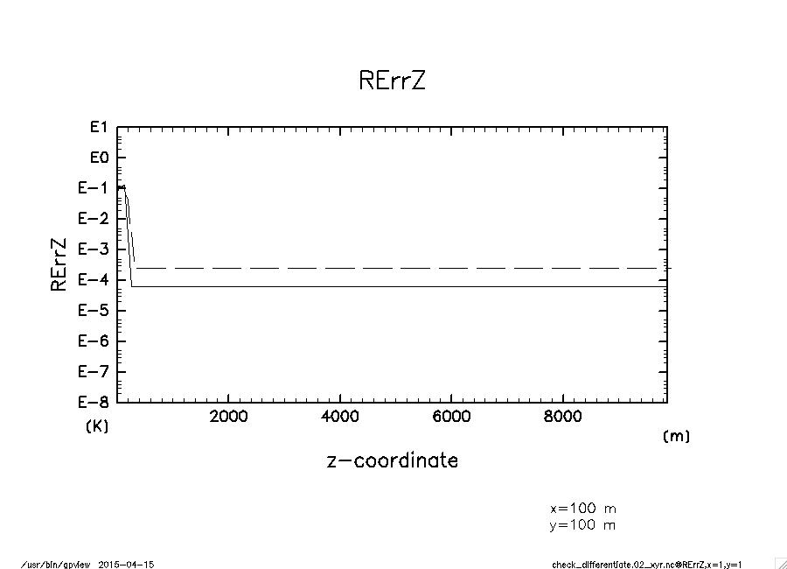
相対誤差
a
実線: (xyr_dz_xyz( xyz_VarZ ) – 解析値) / 解析値
破線：(xyz_dz_xyr( xyr_xyz( xyz_VarZ ) ) – 解析値) / 解析値

Slide 7
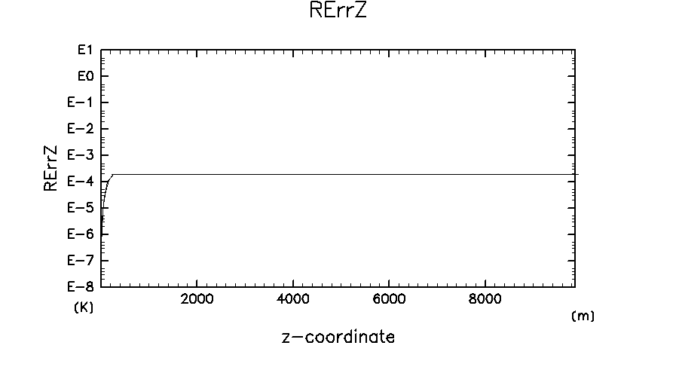
参考：平均操作
実線: (xyz_xyr( xyr_VarZ ) – 解析値) / 解析値
破線： (xyr_xyz( xyz_VarZ ) – 解析値) / 解析値

Slide 8
木星条件

Slide 9
困ったこと: arare4 と arare6 で得られた周期が異なる
方程式系を変更したことにより周期が変わったことを示せれば良いのだが. まだその段階にない.
方法： arare4 から arare6 への途中経過において木星条件の長時間計算を行う. どの段階で周期が大きく変わるか?

Slide 10
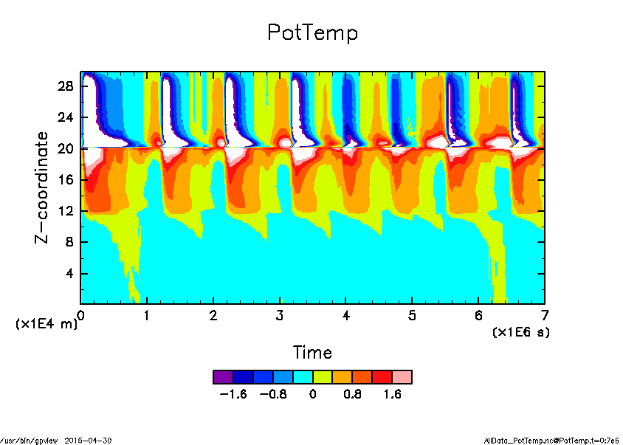
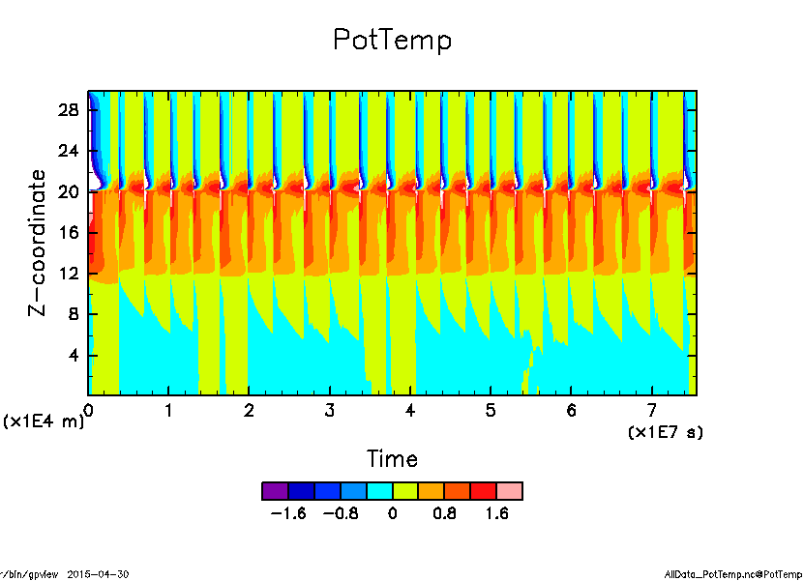
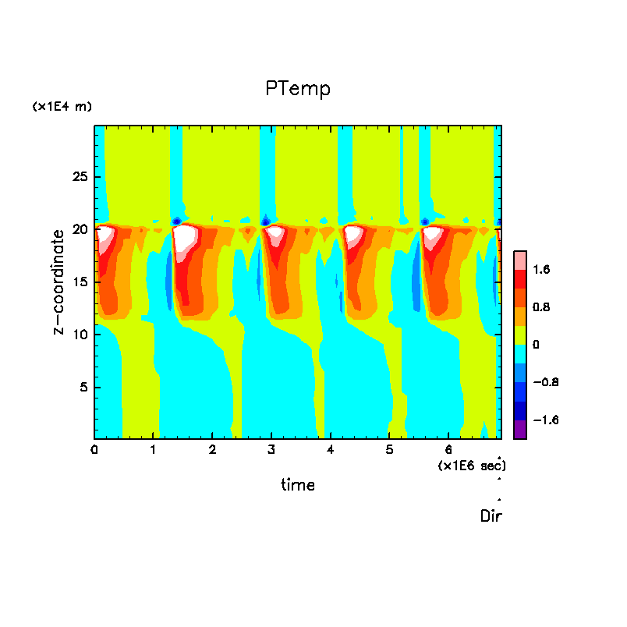
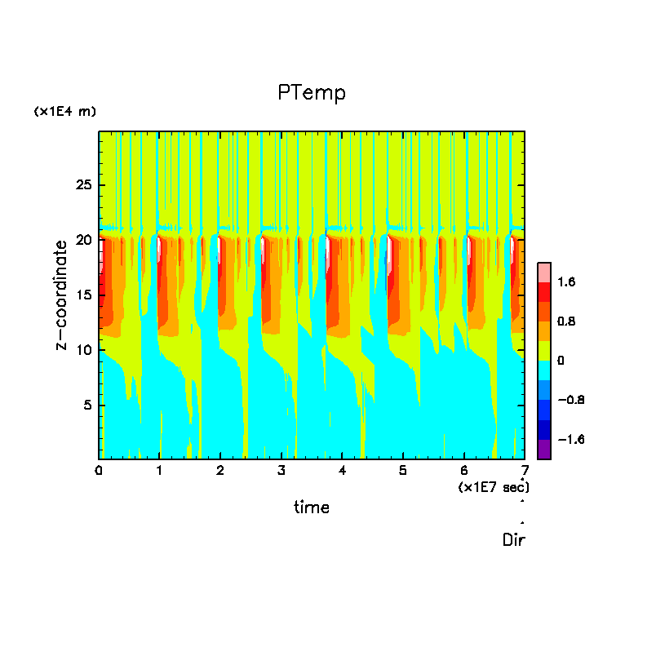
スポンジ層のダンピング係数が違う (300, 5000 sec), 成層圏の基本場は異なる
a
R10: 周期 ~15 day
R1: 周期 ~ 110 day

Slide 11
圧力問題

Slide 12
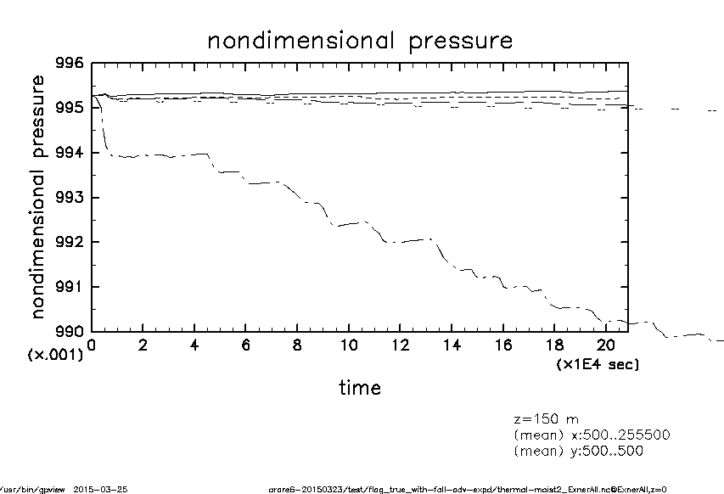

地球条件
全部入りが最もずれない
黒田計算と整合的
Klemp and Wilhelmson (1978) の 2.7b 式について,
実線: 第一項, 第二項, 第三項を考慮した場合
破線: 第一項, 第三項を考慮した場合
点線: 第二項, 第三項を考慮した場合
一点鎖線: 従来と同様の計算. 全て無視
二点鎖線?: 第三項のみ考慮
Notes:
確認のために行った黒田計算の再現計算の結果を添付します (一層目のエクス
ナー関数の時間発展). Klemp and Wilhelmson (1978) の 2.7b 式について,
実線: 第一項, 第二項, 第三項を考慮した場合
破線: 第一項, 第三項を考慮した場合
点線: 第二項, 第三項を考慮した場合
一点鎖線: 従来と同様の計算. 全て無視
二点鎖線?: 第三項のみ考慮
となっています. 第三項 (熱膨張項) の影響が大きいですね. 熱膨張項の影響
を入れると圧力減少する問題がかなり解決されますね, 今更ながら実感しまし
た.
対応する黒田計算は以下です. 一点鎖線の全て無視したケースの圧力のずれ方
は黒田計算と整合的だと思います. 熱膨張項を入れた場合には私の実験の方が
ずれが少ないような. ソース変わっているし, 計算設定も完全に一致していな
いので, 深く追求しても仕方ないかもしれません.
http://www.gfd-dennou.org/arch/deepconv/sample/2013-02-10_mikity/zzz-hikaku/index_thum.htm
http://www.gfd-dennou.org/arch/deepconv/sample/2013-02-19_mikity/arare5-20130125-0214/testrun2D_RadCR-1.0Kday-1_0214/zzz-hikaku/index_thum.htm
# 木星計算もやり直し中.

Slide 13
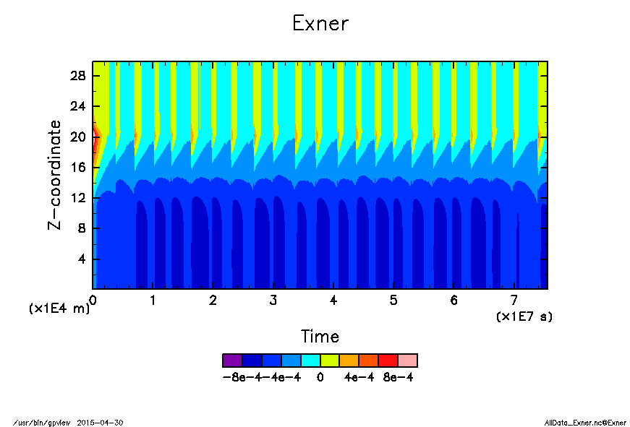
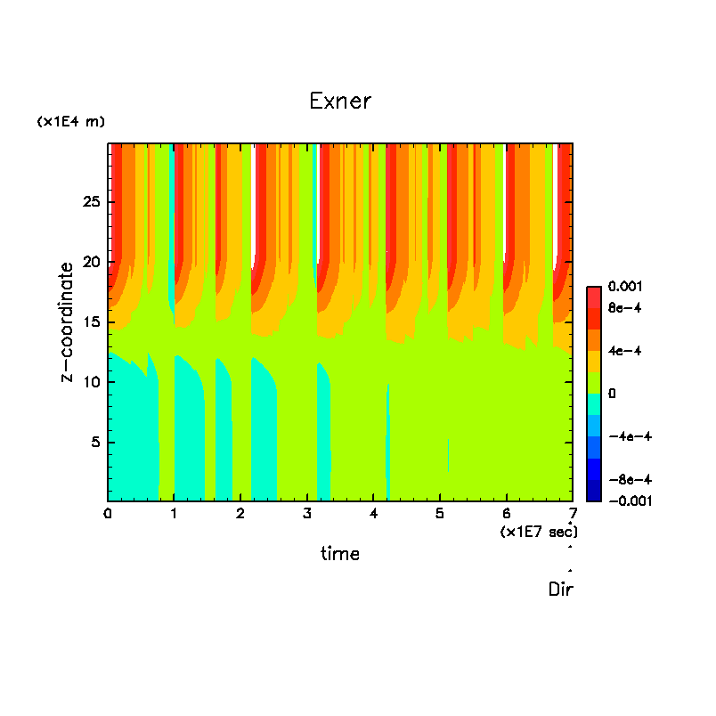
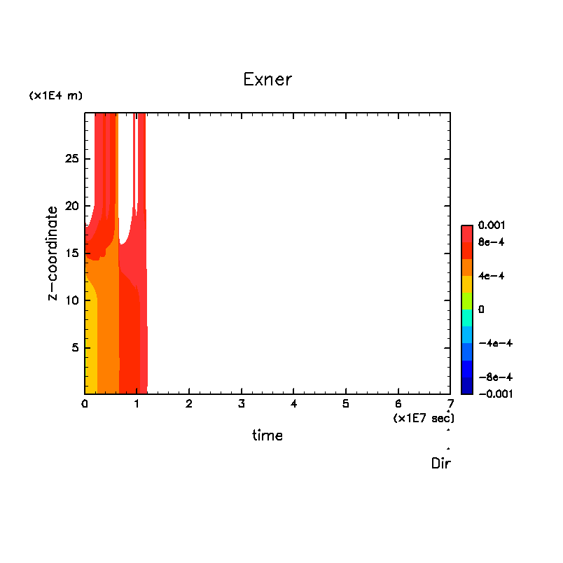
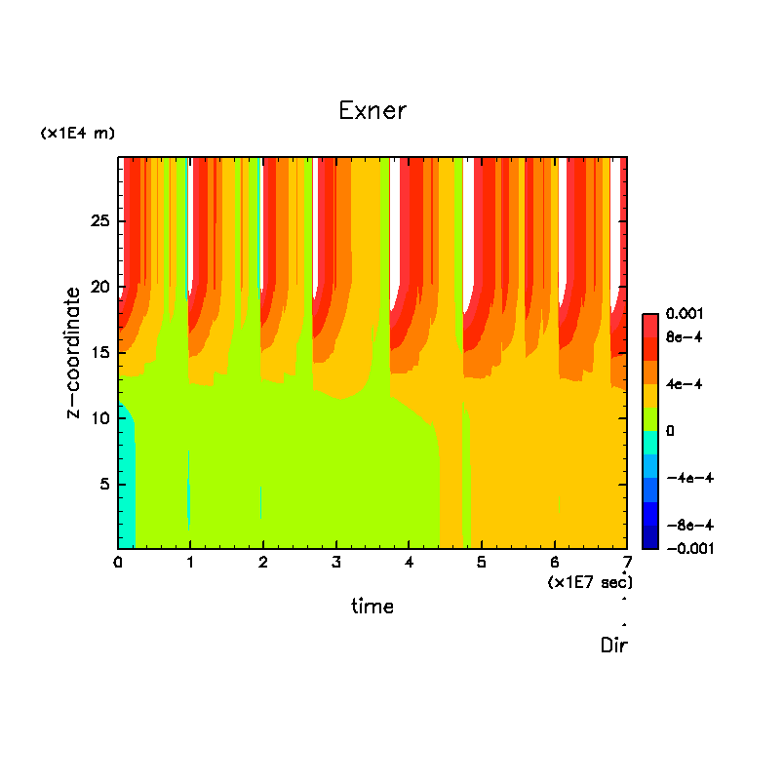
木星条件
全部入りが最もずれる….
どこかにバグがあるのだろうか?
π の値が大きい?
arare4
全部なし 全部入り 凝結にかかわる項のみ

Slide 14
最適化オプション

Slide 15
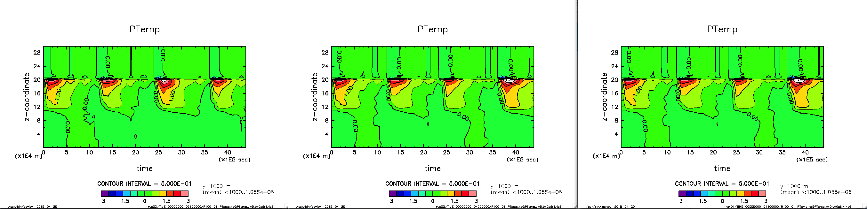
01: -h fp0 -h flex_mp=intolerant -h ipa4 (44) 02: -h fp1 -h flex_mp=intolerant -h ipa4 (49) 03: -h fp2 -h flex_mp=intolerant -h ipa4 (51)

Slide 16
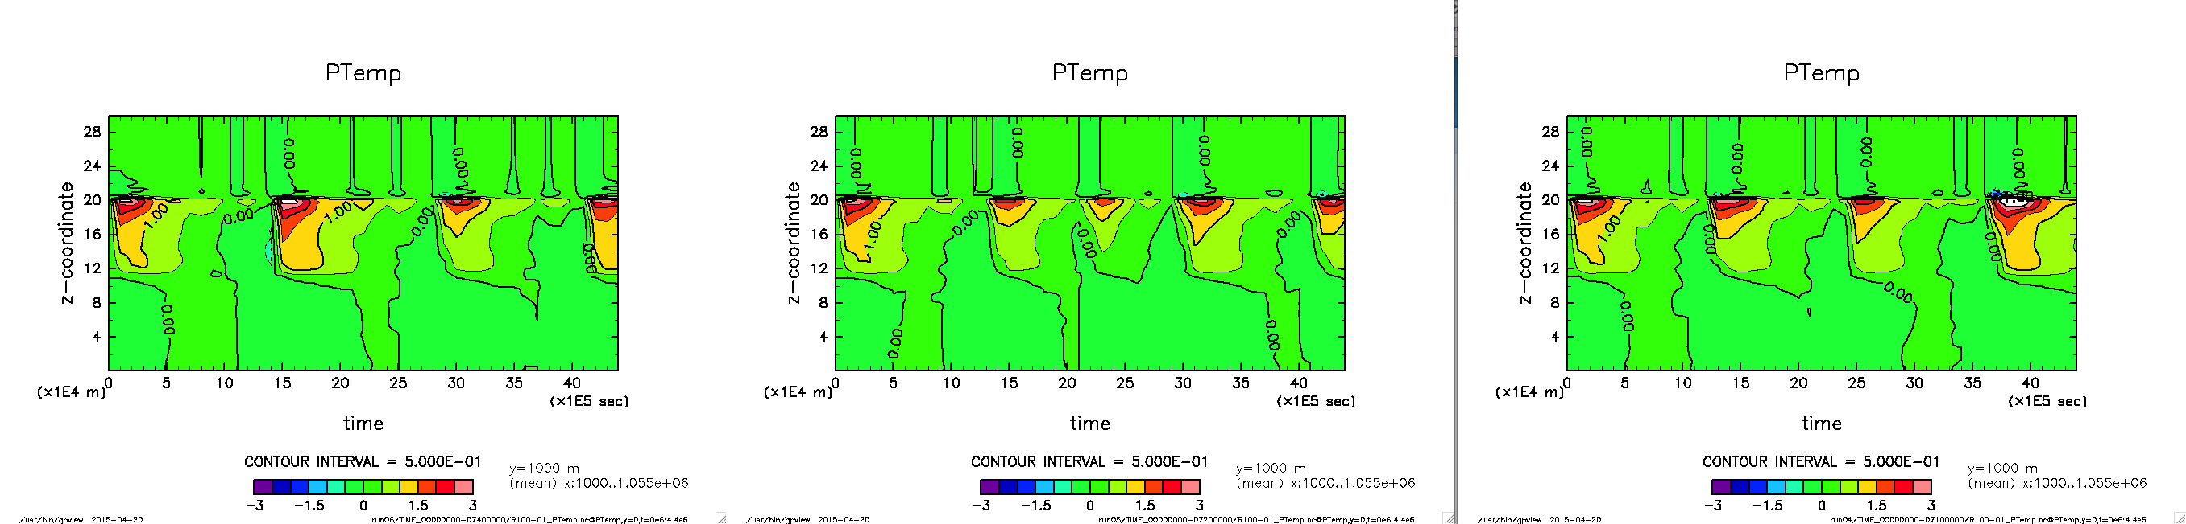
04: -h fp0 –h flex_mp=strict -h ipa4 (71) 05: -h fp1 –h flex_mp=strict -h ipa4 (72) 06: -h fp2 –h flex_mp=strict -h ipa4 (74)
run01, run02 と run04 は一致

Slide 17
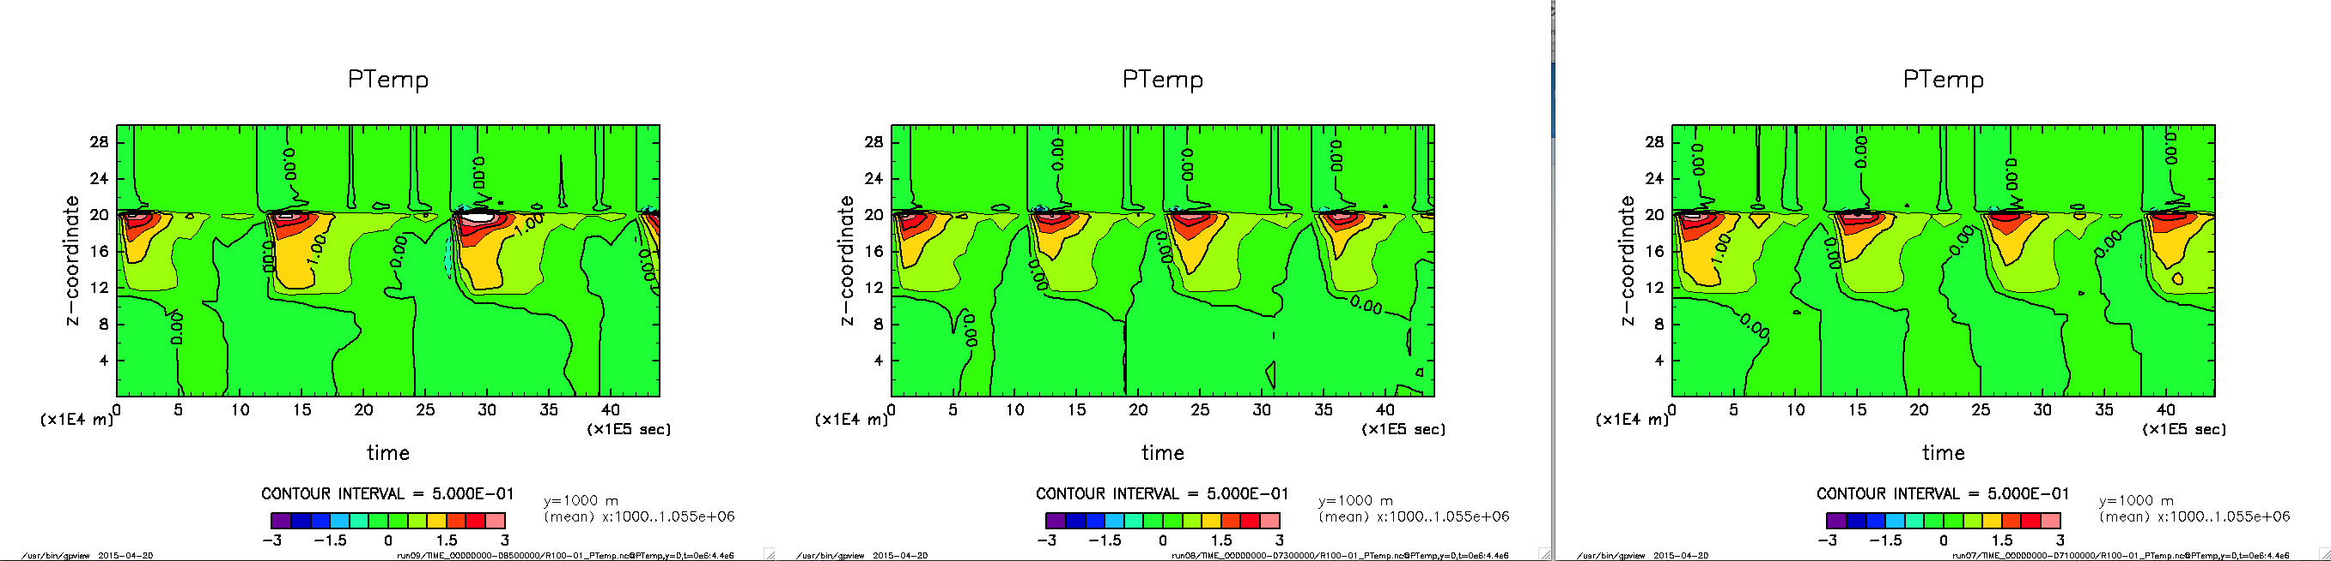
07: -h fp0 –h flex_mp=conservative -h ipa4 (71) 08: -h fp1 –h flex_mp=conservative -h ipa4 (73) 09: -h fp2 –h flex_mp=conservative -h ipa4 (85)

Slide 18
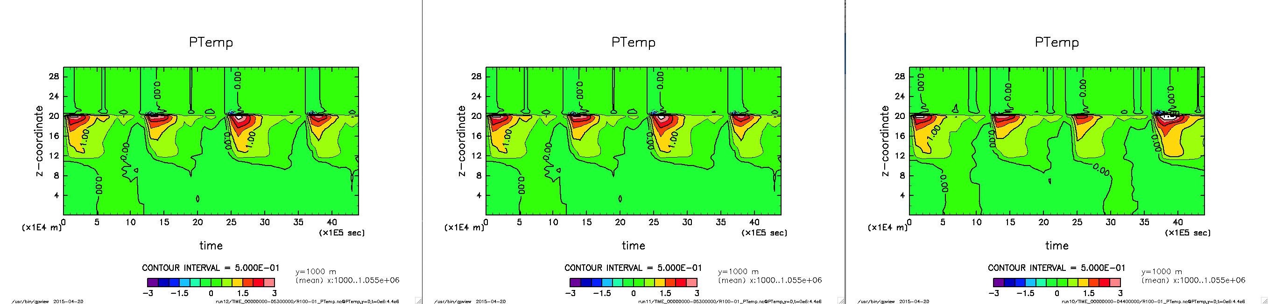
10: -h fp0 -h nofp_trap -h flex_mp=intolerant -h ipa4 (44) 11: -h fp1 -h nofp_trap -h flex_mp=intolerant -h ipa4 (53) 12: -h fp2 -h nofp_trap -h flex_mp=intolerant -h ipa4 (53)
run11, run12 は設定一緒??

Slide 19
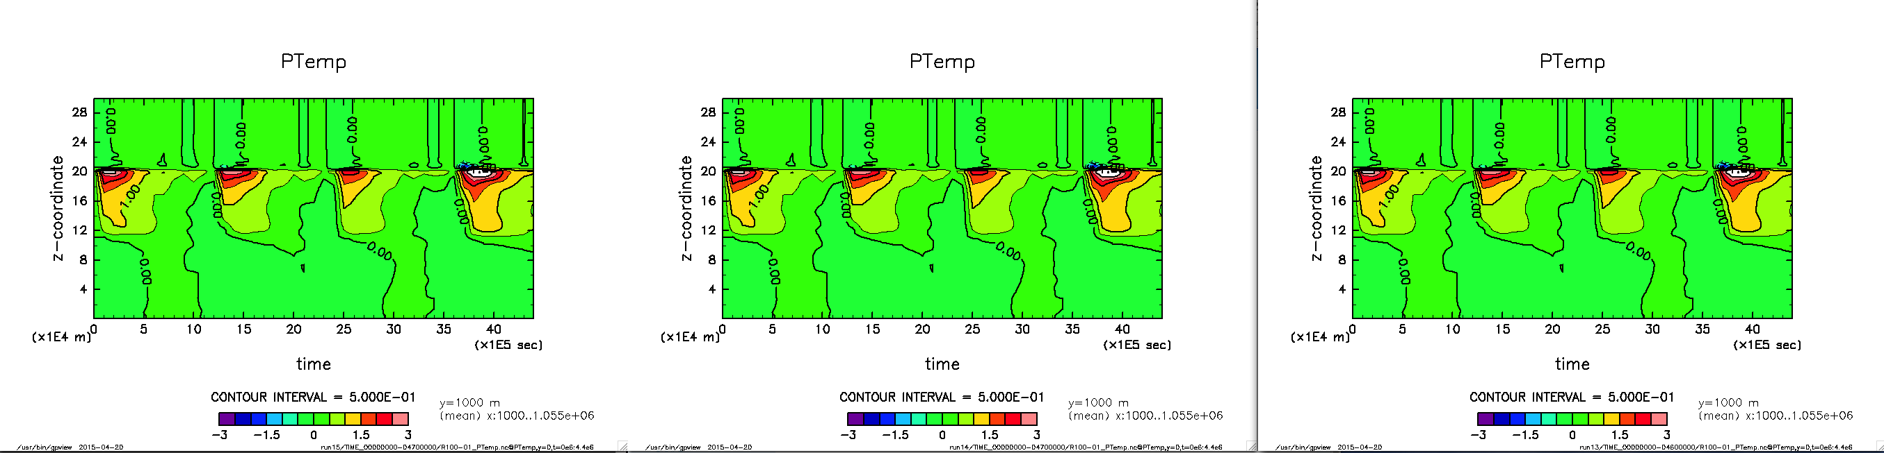
13: -O1 -h fp1 -h flex_mp=intolerant -h ipa2 (46) 14: -O2 -h fp1 -h flex_mp=intolerant –h ipa2 (47) 15: -O3 -h fp1 -h flex_mp=intolerant -h ipa2 (47)
全て run01, run02 と一致

Slide 20
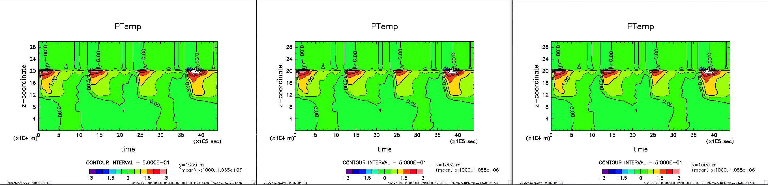
16: -O1 -h fp1 -h flex_mp=intolerant -h ipa3 (46) 17: -O2 -h fp1 -h flex_mp=intolerant –h ipa3 (48) 18: -O3 -h fp1 -h flex_mp=intolerant -h ipa3 (49)
全て run01, run02 と一致

Slide 21
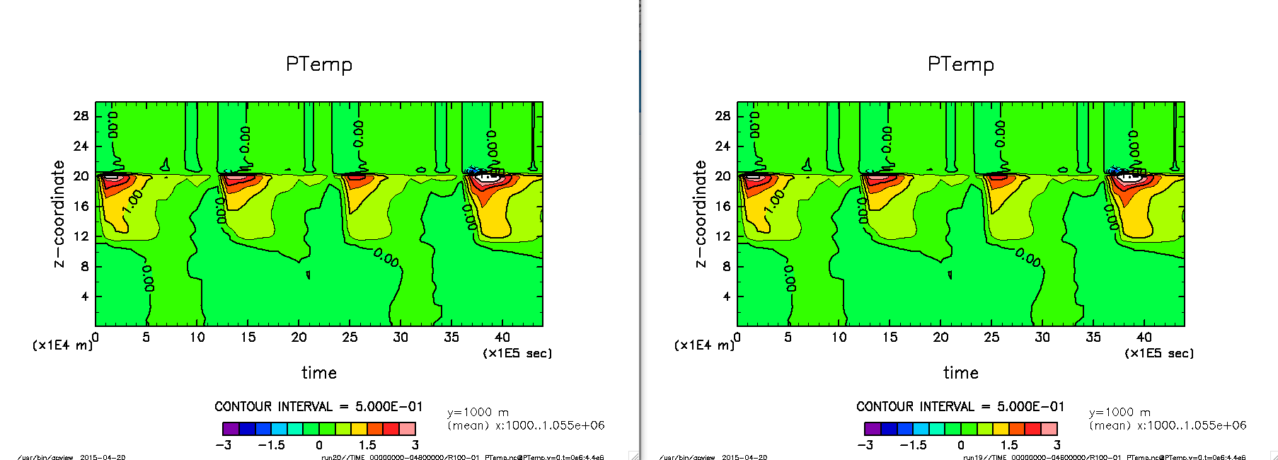
19: -O1 -h fp1 -h flex_mp=intolerant -h ipa4 (46) 20: -O2 -h fp1 -h flex_mp=intolerant -h ipa4 (48) 02: -O3 -h fp1 -h flex_mp=intolerant -h ipa4 (49)
run01, run02 と run04 は一致

Slide 22
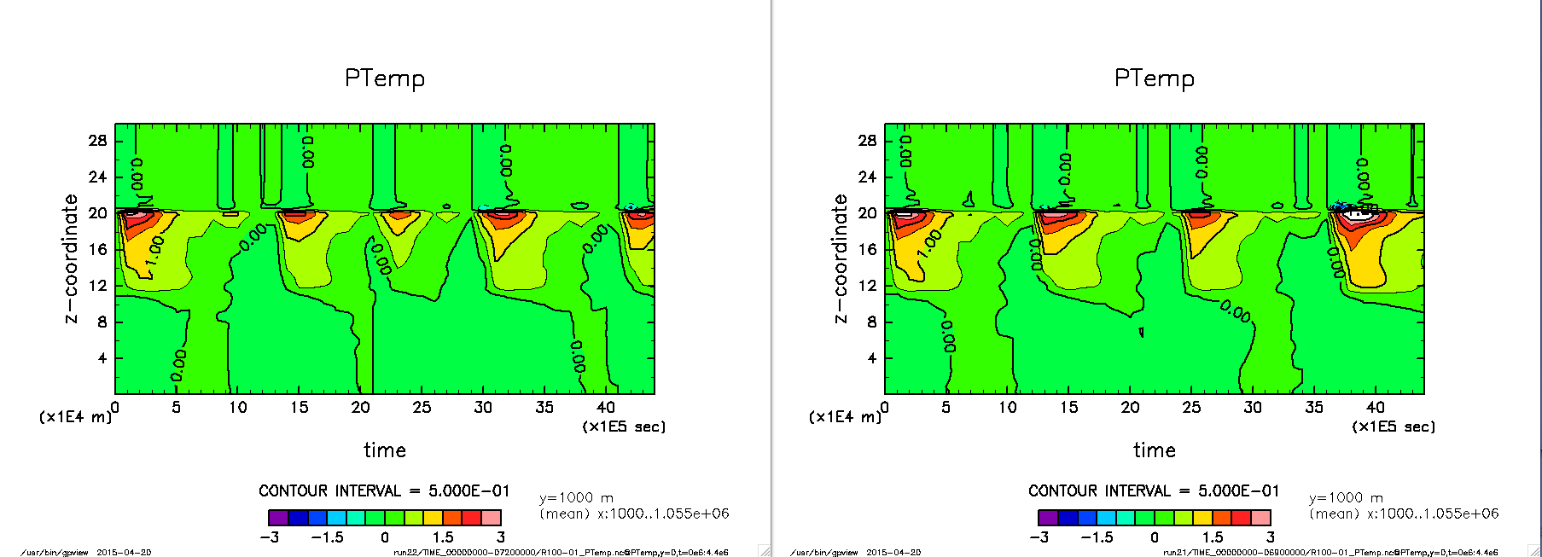
21: -O1 -h fp1 -h flex_mp=intolerant -h ipa4 (69) 22: -O2 -h fp1 -h flex_mp=intolerant -h ipa4 (72) 05: -O3 -h fp1 -h flex_mp=intolerant -h ipa4 (49)
run01, run02 と run04 は一致

Slide 23
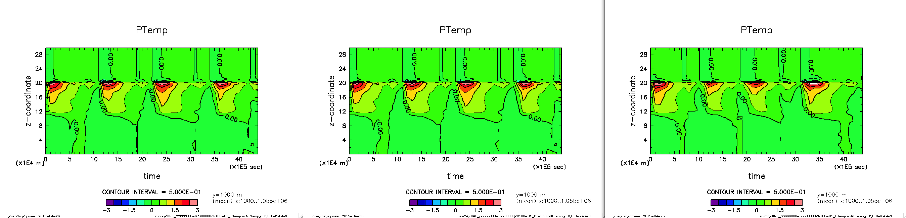
23: -O1 -h fp1 -h flex_mp=conservative -h ipa4 (68) 24: -O2 -h fp1 -h flex_mp=conservative -h ipa4 (72) 08: -O3 -h fp1 -h flex_mp=conservative -h ipa4 (73)
run01, run02 と run04 は一致

Slide 24
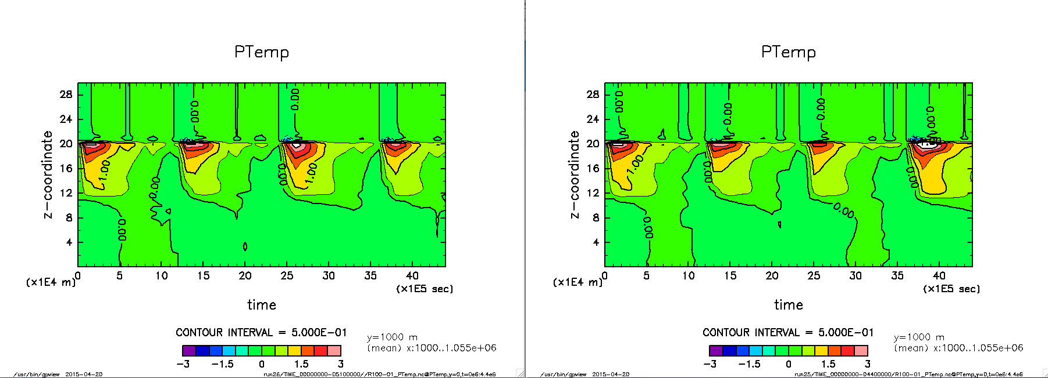
25: -h fp0 -h flex_mp=intolerant -h ipa4 -h nofp_trap (44) 26: -h fp1 -h flex_mp=intolerant -h ipa4 -h nofp_trap (51)

Slide 25
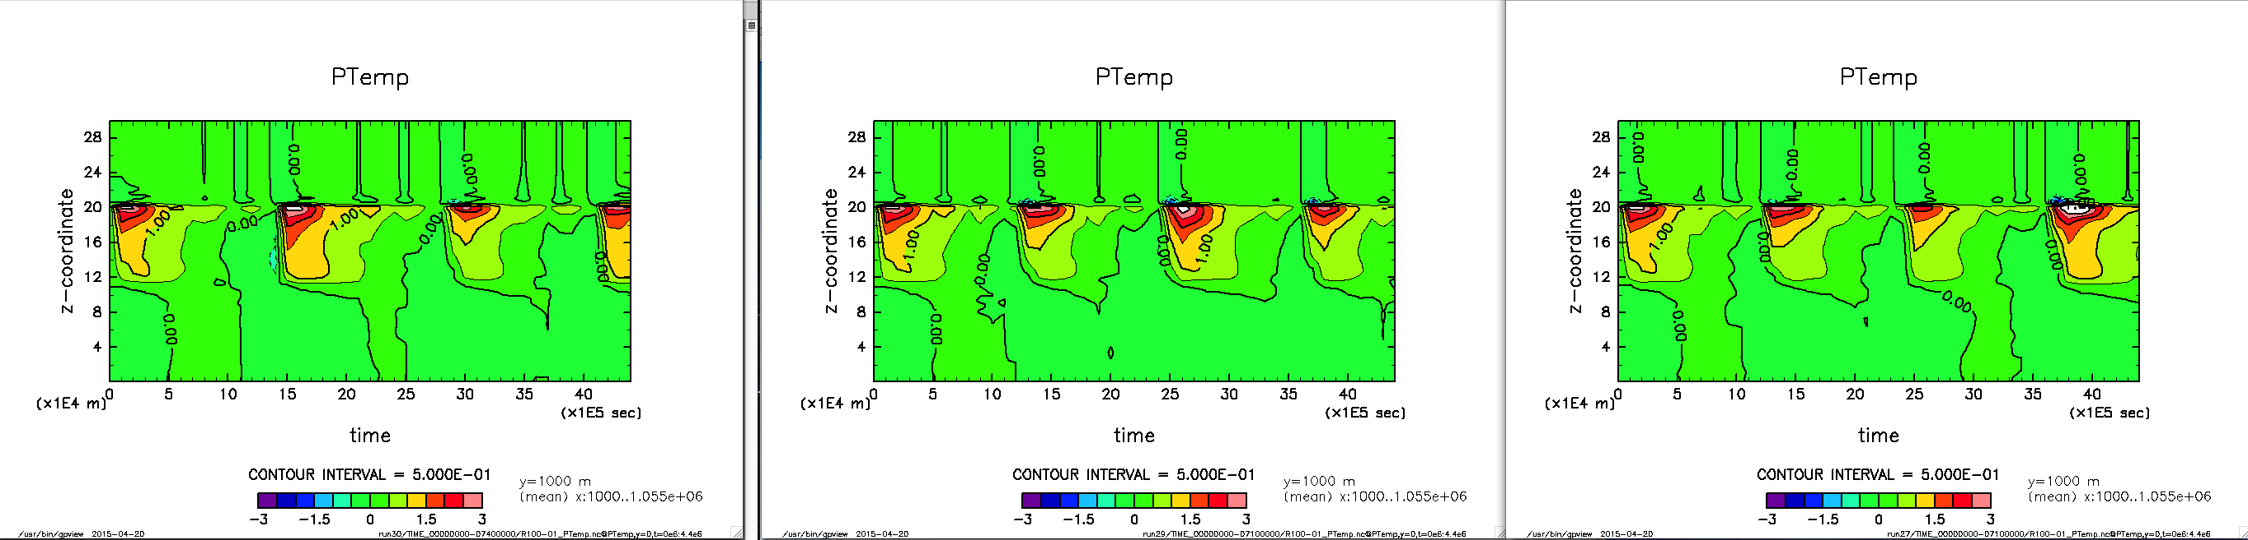
27: -O3 -h fp0 -h flex_mp=strict -h ipa4 -h nofp_trap (71) 28: -O3 -h fp1 -h flex_mp=strict -h ipa4 -h nofp_trap (74) 29: -O1 -h fp1 -h flex_mp=strict -h ipa4 -h nofp_trap (71) 30: -O2 -h fp2 -h flex_mp=strict -h ipa4 -h nofp_trap (74)

Slide 26
###
###
### 基本的に 04 のオプションを使うことにする.
###
### -h fp0 と -h nofp_trap の組み合わせは OK だが, -h fp1 と -h nofp_trap の組み合わせはダメ. => 基本的に -h nofp_trap は付けないこと.
###
01(44)#SYSFFLAGS=-em -O3 -h noautothread -h noomp -h fp0 -h flex_mp=intolerant -h ipa4 $(INCLUDE_GT) $(INCLUDES) -I$(MODDIR) -h display_opt
13(46)#SYSFFLAGS=-em -O1 -h noautothread -h noomp -h fp1 -h flex_mp=intolerant -h ipa2 $(INCLUDE_GT) $(INCLUDES) -I$(MODDIR) -h display_opt
16(46)#SYSFFLAGS=-em -O1 -h noautothread -h noomp -h fp1 -h flex_mp=intolerant -h ipa3 $(INCLUDE_GT) $(INCLUDES) -I$(MODDIR) -h display_opt
19(46)#SYSFFLAGS=-em -O1 -h noautothread -h noomp -h fp1 -h flex_mp=intolerant -h ipa4 $(INCLUDE_GT) $(INCLUDES) -I$(MODDIR) -h display_opt 14(47)#SYSFFLAGS=-em -O2 -h noautothread -h noomp -h fp1 -h flex_mp=intolerant -h ipa2 $(INCLUDE_GT) $(INCLUDES) -I$(MODDIR) -h display_opt
15(47)#SYSFFLAGS=-em -O3 -h noautothread -h noomp -h fp1 -h flex_mp=intolerant -h ipa2 $(INCLUDE_GT) $(INCLUDES) -I$(MODDIR) -h display_opt
17(48)#SYSFFLAGS=-em -O2 -h noautothread -h noomp -h fp1 -h flex_mp=intolerant -h ipa3 $(INCLUDE_GT) $(INCLUDES) -I$(MODDIR) -h display_opt
20(48)#SYSFFLAGS=-em -O2 -h noautothread -h noomp -h fp1 -h flex_mp=intolerant -h ipa4 $(INCLUDE_GT) $(INCLUDES) -I$(MODDIR) -h display_opt
02(49)#SYSFFLAGS=-em -O3 -h noautothread -h noomp -h fp1 -h flex_mp=intolerant -h ipa4 $(INCLUDE_GT) $(INCLUDES) -I$(MODDIR) -h display_opt
18(49)#SYSFFLAGS=-em -O3 -h noautothread -h noomp -h fp1 -h flex_mp=intolerant -h ipa3 $(INCLUDE_GT) $(INCLUDES) -I$(MODDIR) -h display_opt
21(69)#SYSFFLAGS=-em -O1 -h noautothread -h noomp -h fp1 -h flex_mp=strict -h ipa4 $(INCLUDE_GT) $(INCLUDES) -I$(MODDIR) -h display_opt
04(71)#SYSFFLAGS=-em -O3 -h noautothread -h noomp -h fp0 -h flex_mp=strict -h ipa4 $(INCLUDE_GT) $(INCLUDES) -I$(MODDIR) -h display_opt
27(71)#SYSFFLAGS=-em -O3 -h noautothread -h noomp -h fp0 -h flex_mp=strict -h ipa4 -h nofp_trap $(INCLUDE_GT) $(INCLUDES) -I$(MODDIR) -h display_opt
10(44)#SYSFFLAGS=-em -O3 -h noautothread -h noomp -h fp0 -h nofp_trap -h flex_mp=intolerant -h ipa4 $(INCLUDE_GT) $(INCLUDES) -I$(MODDIR) -h display_opt
25(44)#SYSFFLAGS=-em -O3 -h noautothread -h noomp -h fp0 -h flex_mp=intolerant -h ipa4 -h nofp_trap $(INCLUDE_GT) $(INCLUDES) -I$(MODDIR) -h display_opt
###
### intolerant
### 全て結果が一致
###
03(51)#SYSFFLAGS=-em -O3 -h noautothread -h noomp -h fp2 -h flex_mp=intolerant -h ipa4 $(INCLUDE_GT) $(INCLUDES) -I$(MODDIR) -h display_opt
26(51)#SYSFFLAGS=-em -O3 -h noautothread -h noomp -h fp1 -h flex_mp=intolerant -h ipa4 -h nofp_trap $(INCLUDE_GT) $(INCLUDES) -I$(MODDIR) -h display_opt
11(53)#SYSFFLAGS=-em -O3 -h noautothread -h noomp -h fp1 -h nofp_trap -h flex_mp=intolerant -h ipa4 $(INCLUDE_GT) $(INCLUDES) -I$(MODDIR) -h display_opt
12(53)#SYSFFLAGS=-em -O3 -h noautothread -h noomp -h fp2 -h nofp_trap -h flex_mp=intolerant -h ipa4 $(INCLUDE_GT) $(INCLUDES) -I$(MODDIR) -h display_opt
05(72)#SYSFFLAGS=-em -O3 -h noautothread -h noomp -h fp1 -h flex_mp=strict -h ipa4 $(INCLUDE_GT) $(INCLUDES) -I$(MODDIR) -h display_opt
28(75)#SYSFFLAGS=-em -O3 -h noautothread -h noomp -h fp1 -h flex_mp=strict -h ipa4 -h nofp_trap $(INCLUDE_GT) $(INCLUDES) -I$(MODDIR) -h display_opt
06(74)#SYSFFLAGS=-em -O3 -h noautothread -h noomp -h fp2 -h flex_mp=strict -h ipa4 $(INCLUDE_GT) $(INCLUDES) -I$(MODDIR) -h display_opt
22(72)#SYSFFLAGS=-em -O2 -h noautothread -h noomp -h fp1 -h flex_mp=strict -h ipa4 $(INCLUDE_GT) $(INCLUDES) -I$(MODDIR) -h display_opt
30(71)#SYSFFLAGS=-em -O2 -h noautothread -h noomp -h fp2 -h flex_mp=strict -h ipa4 -h nofp_trap $(INCLUDE_GT) $(INCLUDES) -I$(MODDIR) -h display_opt
29(71)#SYSFFLAGS=-em -O1 -h noautothread -h noomp -h fp1 -h flex_mp=strict -h ipa4 -h nofp_trap $(INCLUDE_GT) $(INCLUDES) -I$(MODDIR) -h display_opt
###
### conservative
### 08 と 024 は一致
###
07(71)#SYSFFLAGS=-em -O3 -h noautothread -h noomp -h fp0 -h flex_mp=conservative -h ipa4 $(INCLUDE_GT) $(INCLUDES) -I$(MODDIR) -h display_opt
24(72)#SYSFFLAGS=-em -O2 -h noautothread -h noomp -h fp1 -h flex_mp=conservative -h ipa4 $(INCLUDE_GT) $(INCLUDES) -I$(MODDIR) -h display_opt
08(73)#SYSFFLAGS=-em -O3 -h noautothread -h noomp -h fp1 -h flex_mp=conservative -h ipa4 $(INCLUDE_GT) $(INCLUDES) -I$(MODDIR) -h display_opt
23(68)#SYSFFLAGS=-em -O1 -h noautothread -h noomp -h fp1 -h flex_mp=conservative -h ipa4 $(INCLUDE_GT) $(INCLUDES) -I$(MODDIR) -h display_opt
09(85)#SYSFFLAGS=-em -O3 -h noautothread -h noomp -h fp2 -h flex_mp=conservative -h ipa4 $(INCLUDE_GT) $(INCLUDES) -I$(MODDIR) -h display_opt

