Slide 1
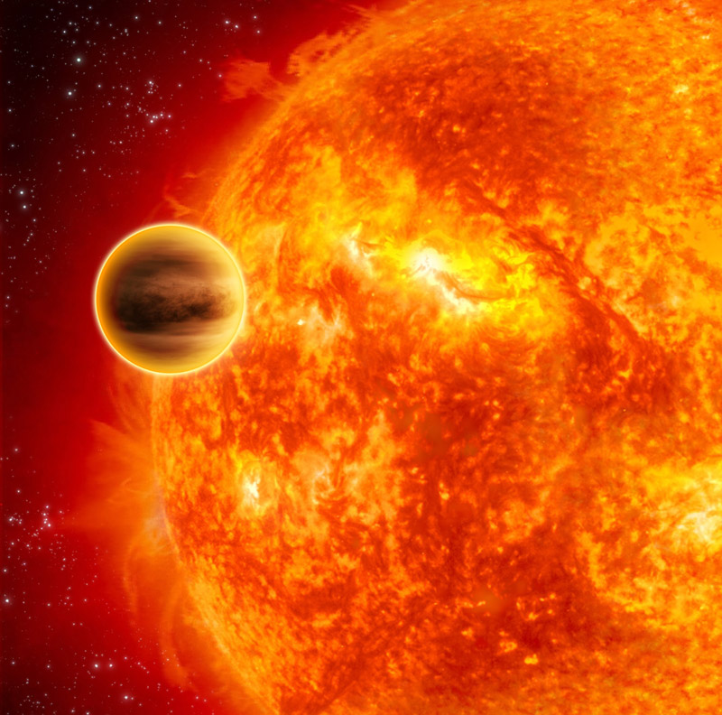
Atmospheric Circulation of hot Jupiters
Adam Showman
University of Arizona
Collaborators: Nikole Lewis, Tad Komacek, Jonathan Fortney, Lorenzo Polvani, Yuan Lian, Mark Marley, Yohai Kaspi, Tiffany Kataria

Slide 2
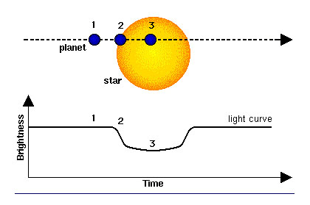
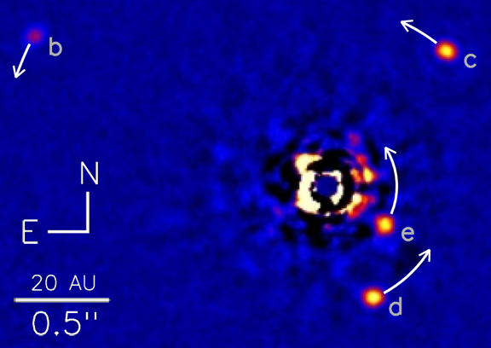
Exoplanets: an exploding new field
Over 3500 known extrasolar planets
Nearly 700 planets have been detected with the “Doppler” method
Nearly 2700 planets have been detected with “transit” method (plus many Kepler candidates):
Together, these give the planetary mass, radius, and orbital properties.
~50 planets discovered by direct imaging:

Slide 3
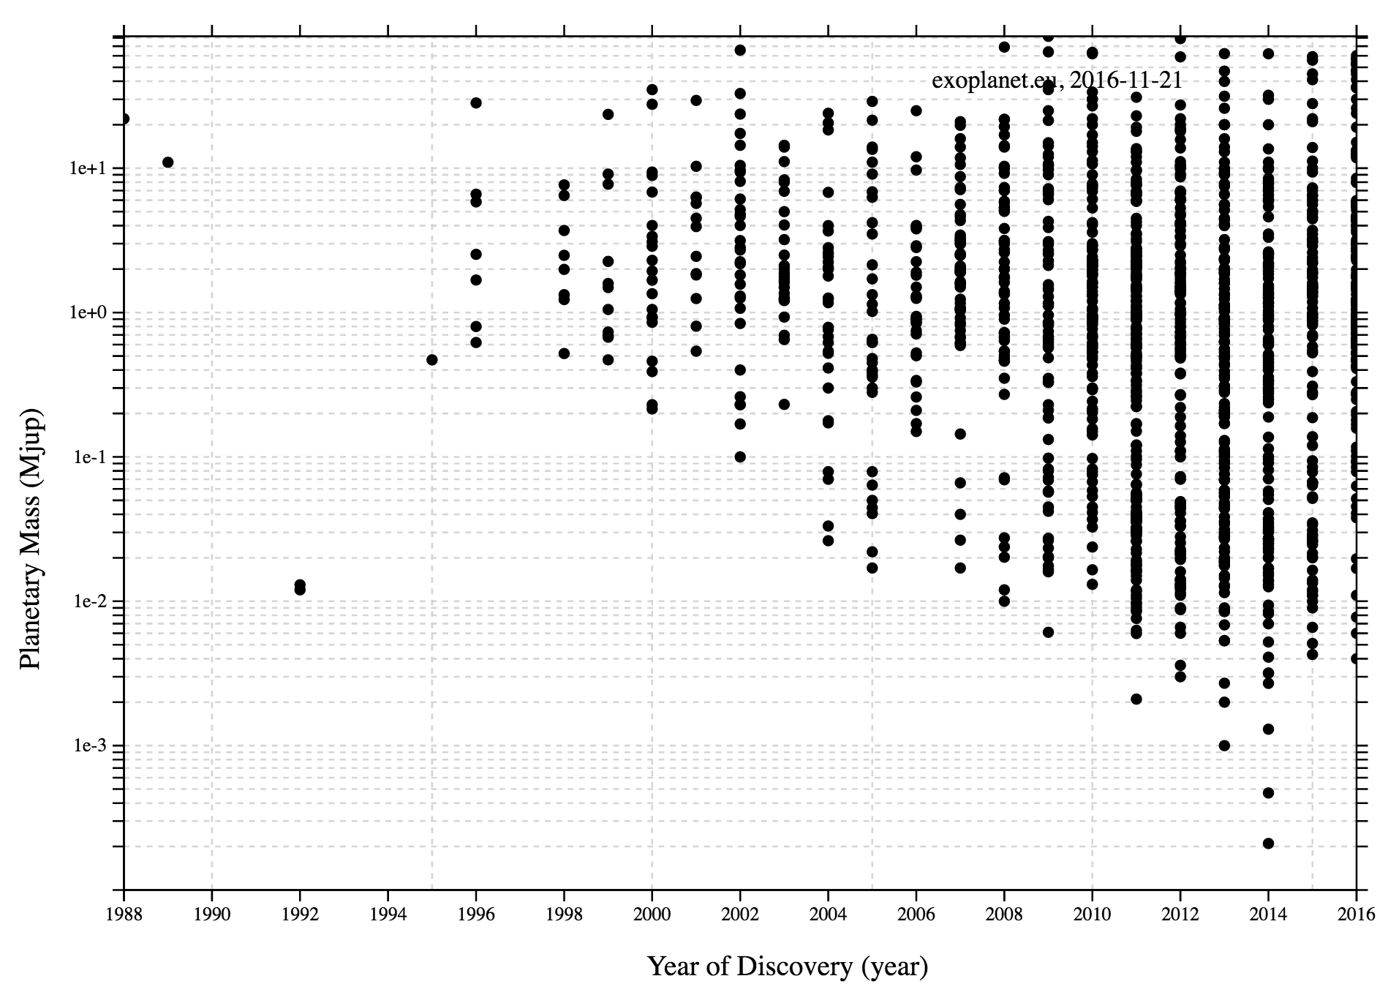
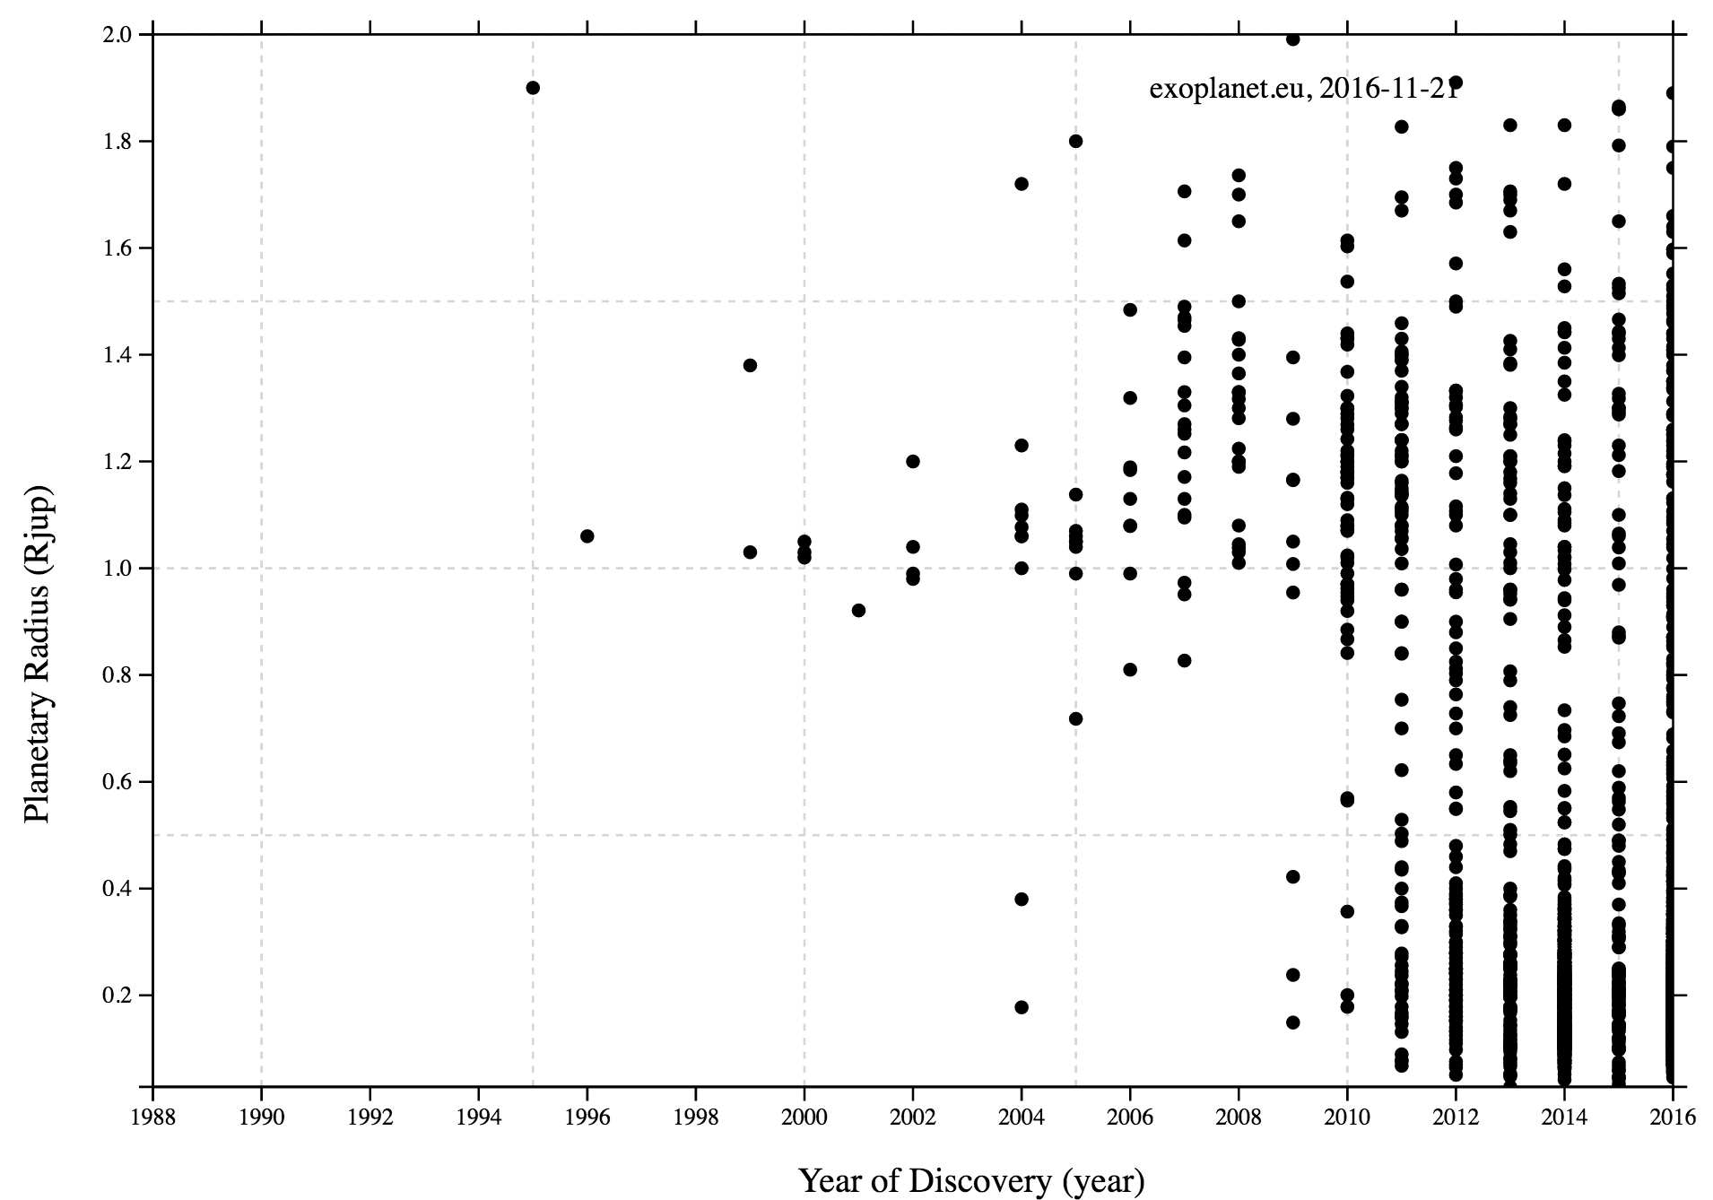
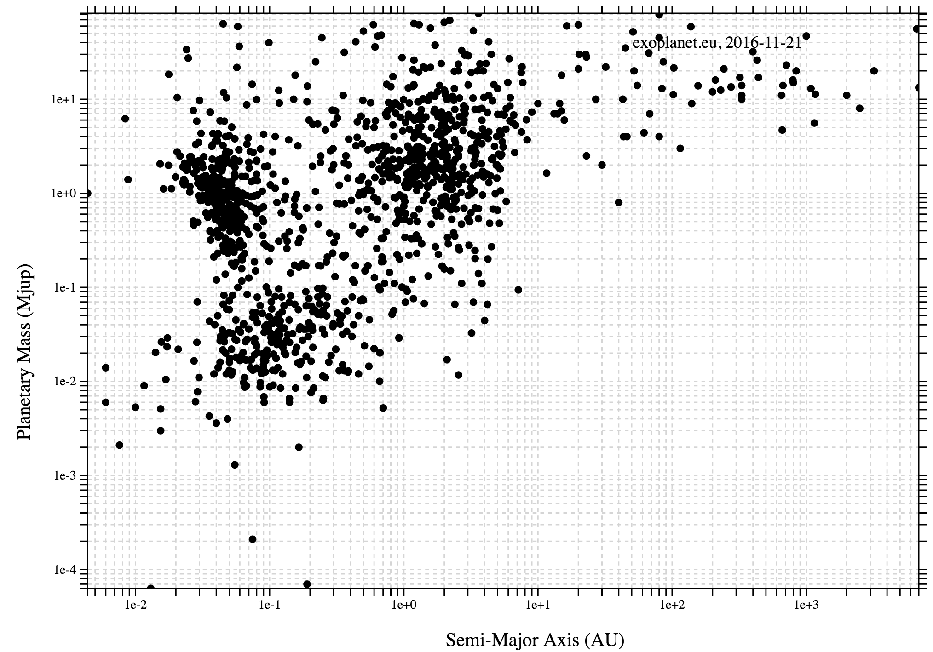
Planet mass vs. year of discovery
Planet radius vs. year of discovery
Planet mass vs. semi-major axis

Slide 4
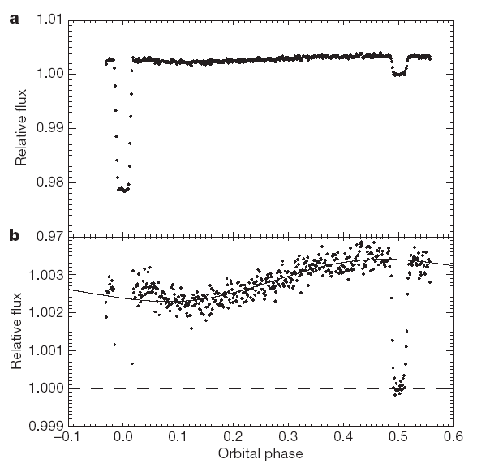
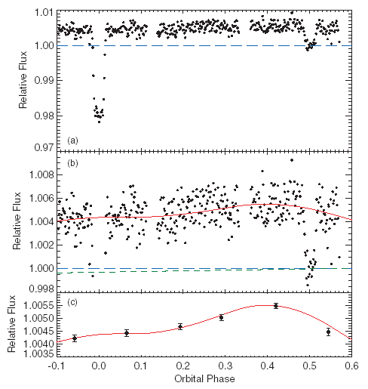
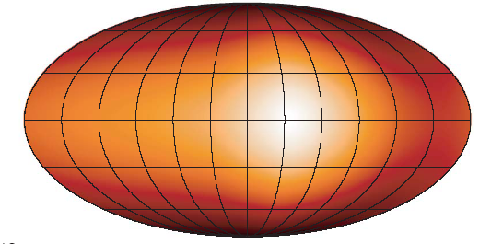
Hot Jupiters: Spitzer light curves for HD 189733b
Knutson et al. (2007, 2009)
8 μm
24 μm

Slide 5
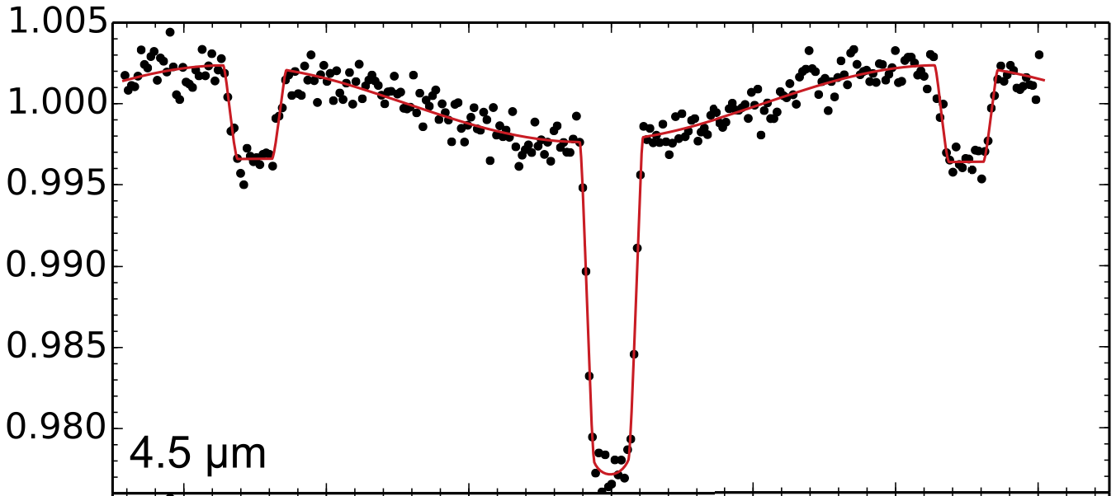
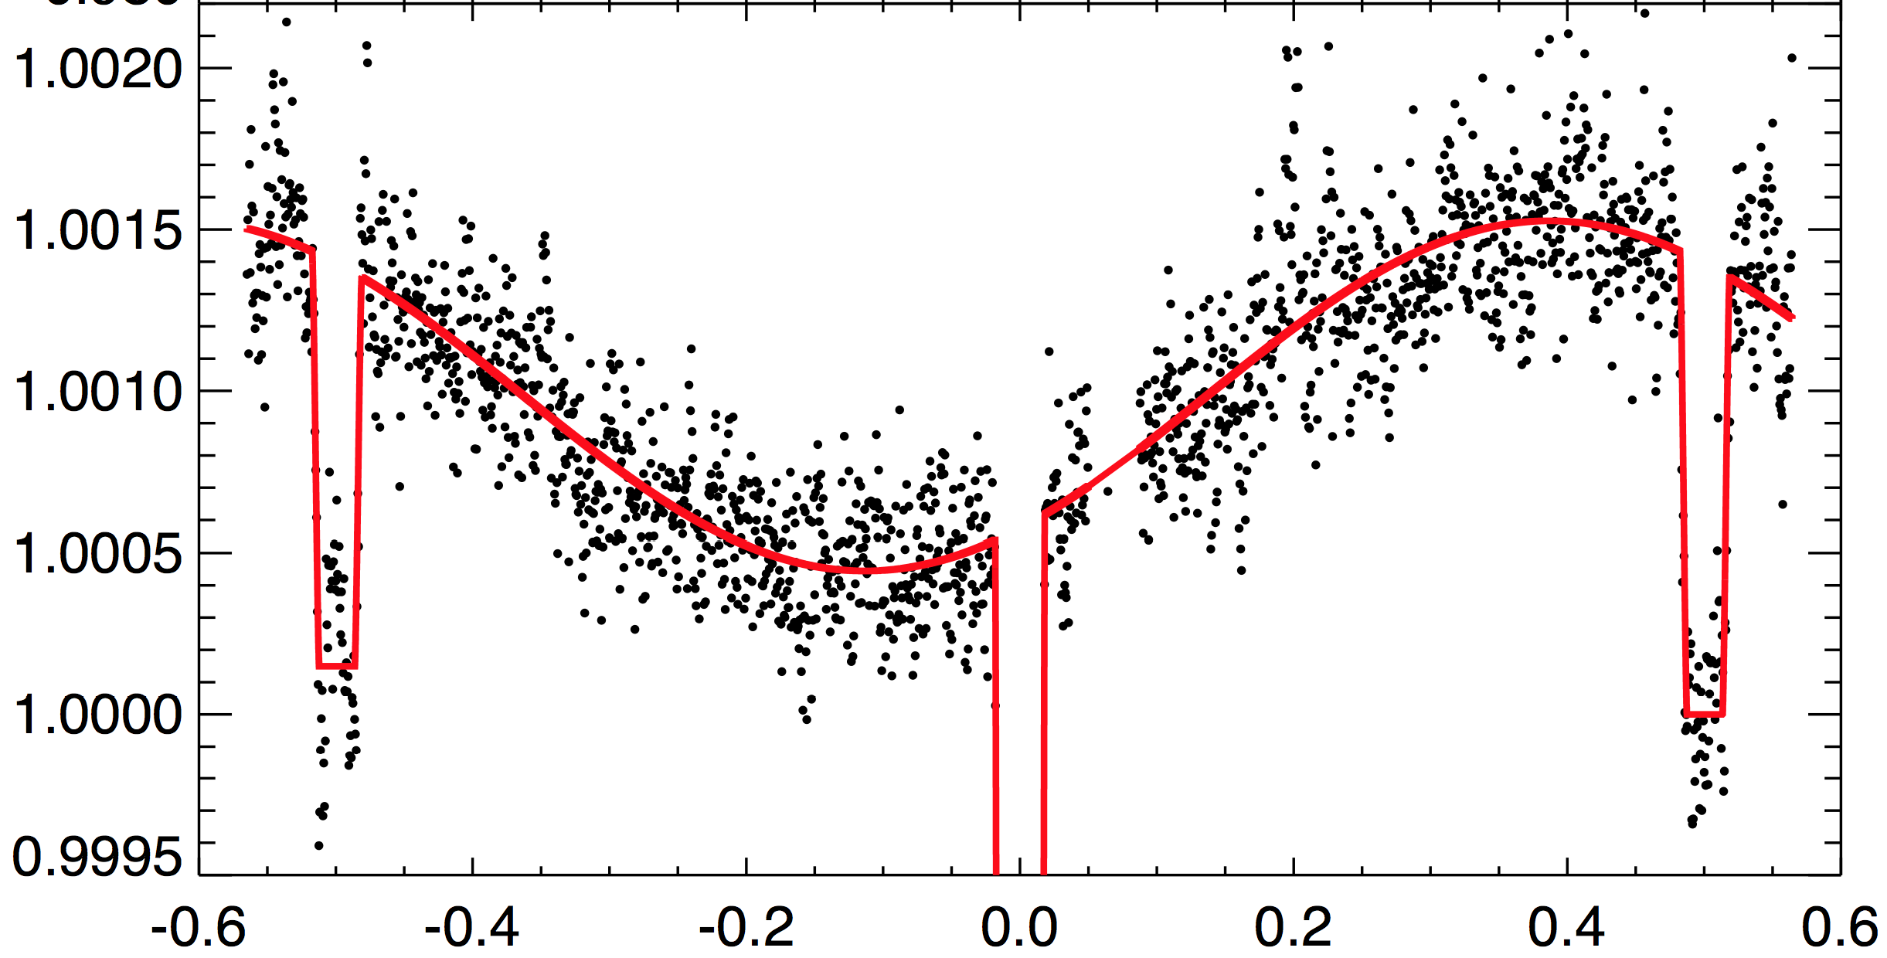
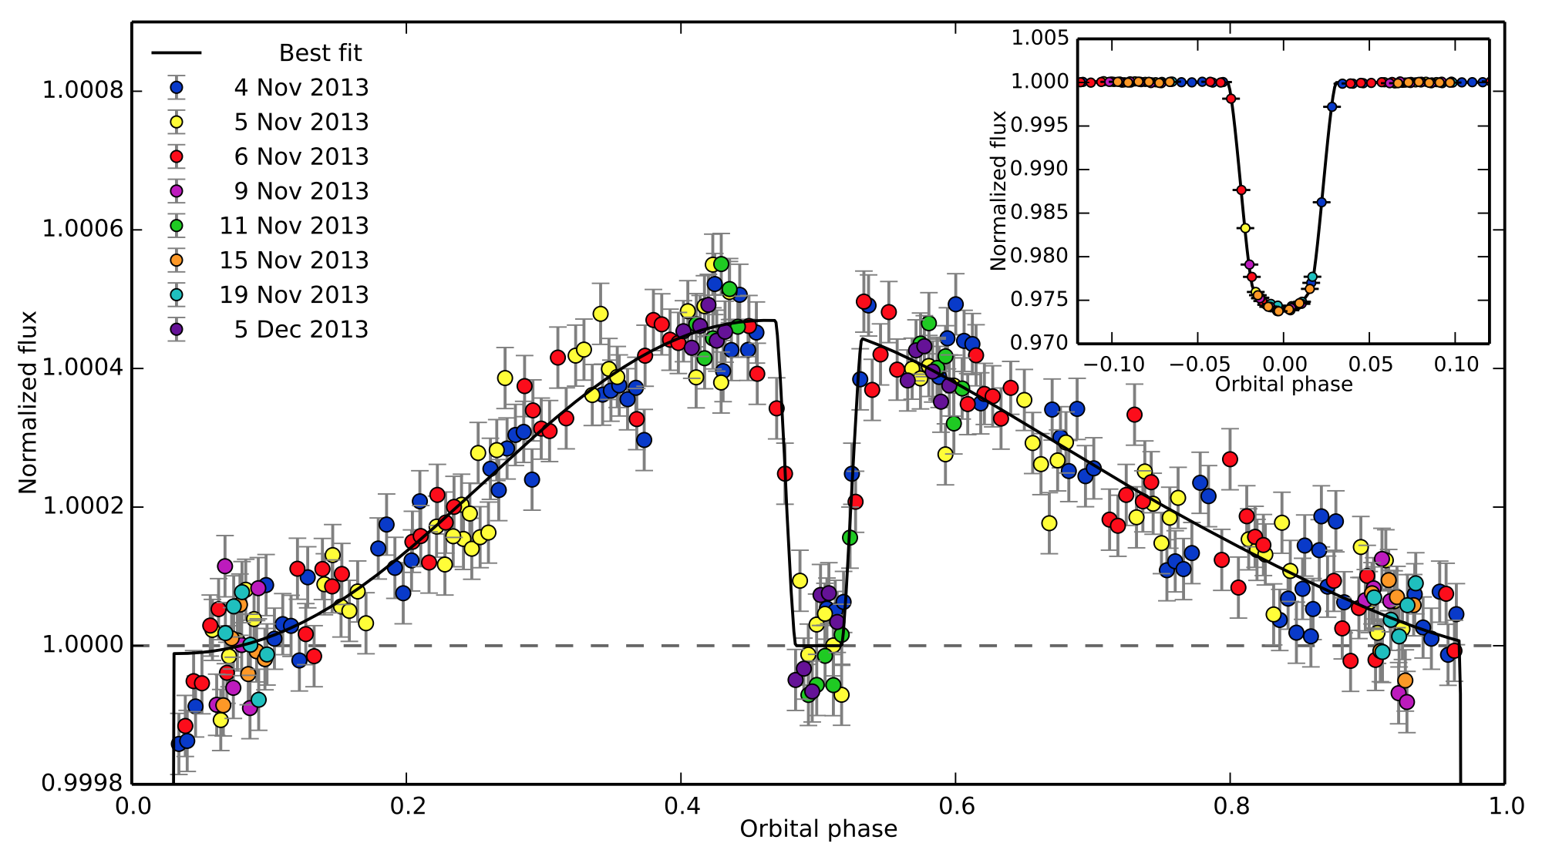
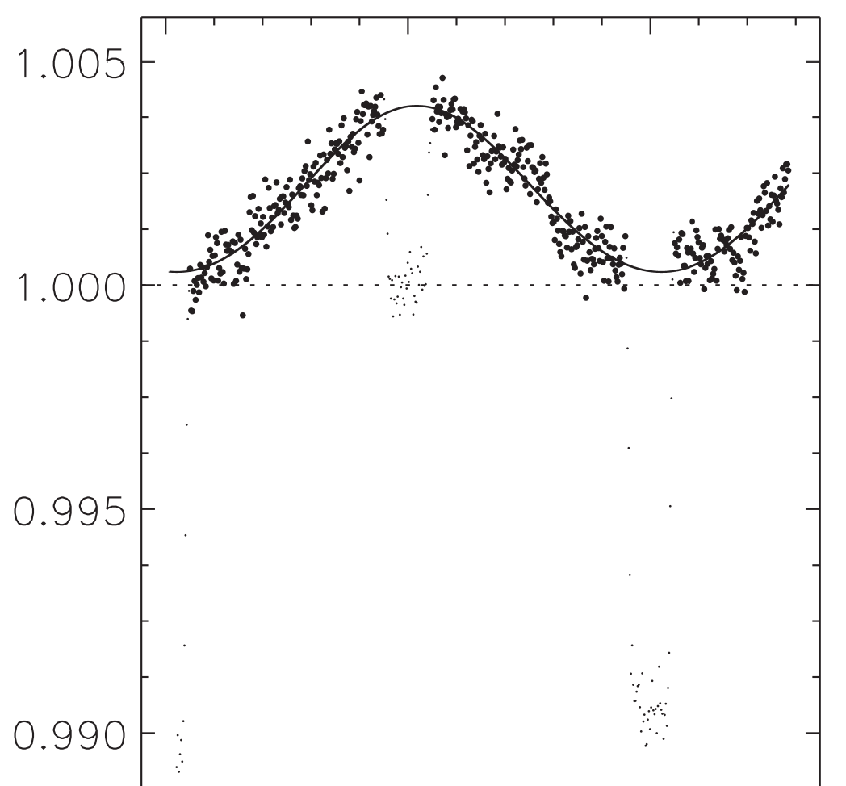
Lightcurves for hot Jupiters
WASP-19b (Wong et al. 2016)
HD209458b (Zellem et al. 2014)
WASP-43b (Stevenson et al. 2014)
WASP-18b (Maxted et al. 2013)

Slide 6

Dependence of day-night flux contrast on effective temperature
Komacek & Showman (2016)

Slide 7
Motivating questions
What are the fundamental dynamics of the highly irradiated “hot Jupiter” circulation regime? Can we explain lightcurves of specific hot Jupiters? What is the mechanism for displacing the hottest regions to the east?
What are mechanisms for controlling the day-night temperature contrast on hot Jupiters? Can we explain the increasing trend of day-night flux contrast with incident stellar flux?
What controls the cloudiness of hot Jupiters?
How do circulation regime---and observables---of hot Jupiters vary with parameters like incident stellar flux and rotation rate?

Slide 8
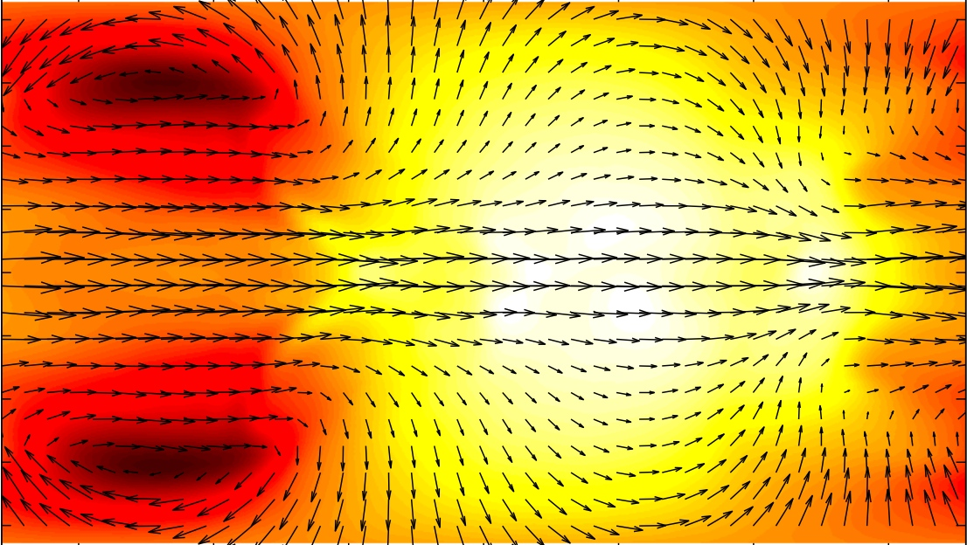
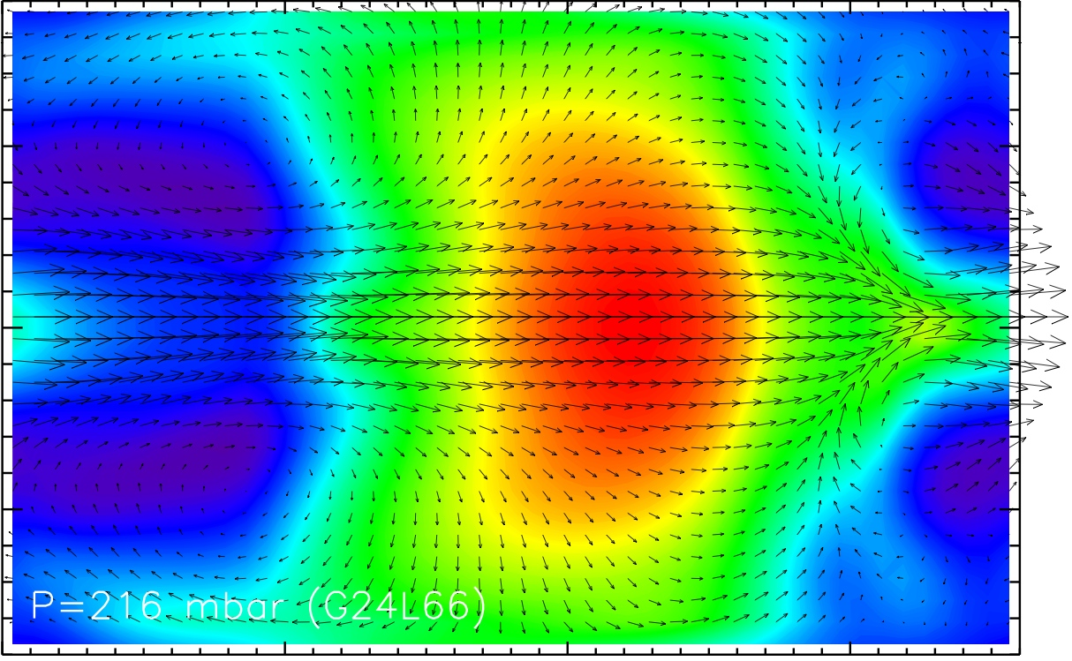
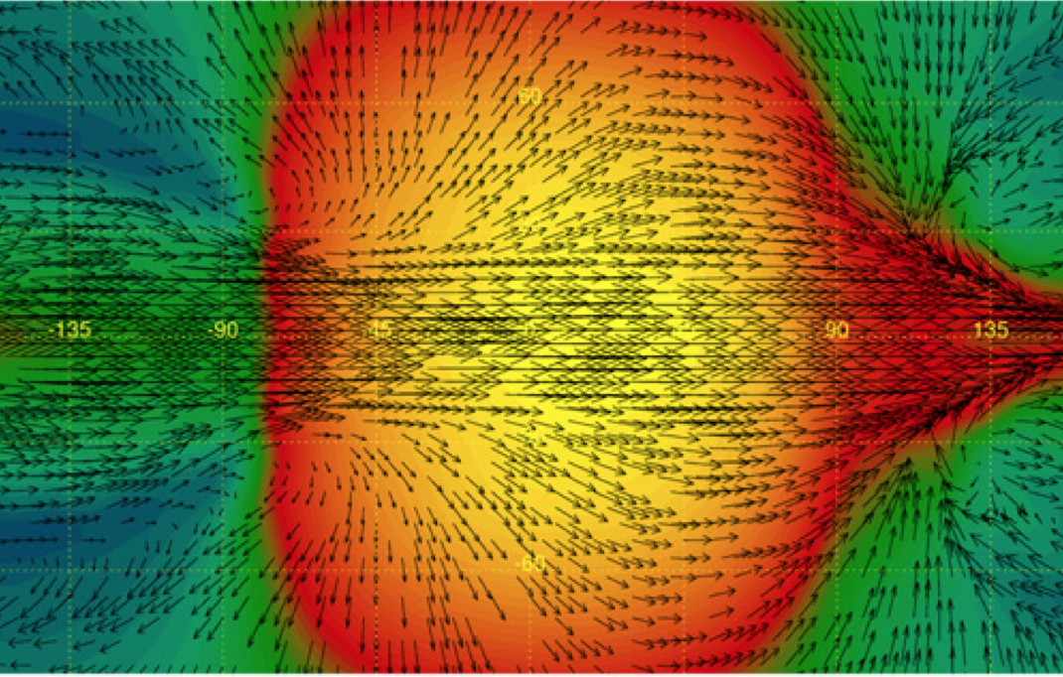
Hot Jupiter circulation models typically predict several broad, fast jets including equatorial superrotation
Showman et al. (2009)
Heng et al. (2010)
Rauscher & Menou (2012)

Slide 9
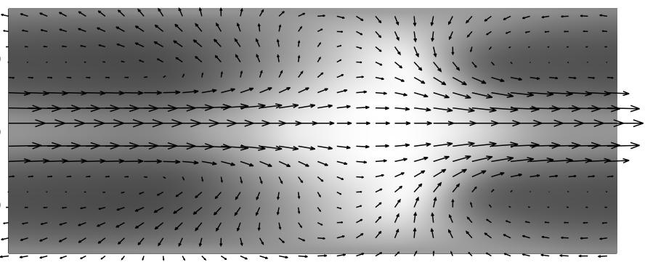
Showman &
Guillot (2002)
Knutson et al.
(2007)

Slide 10
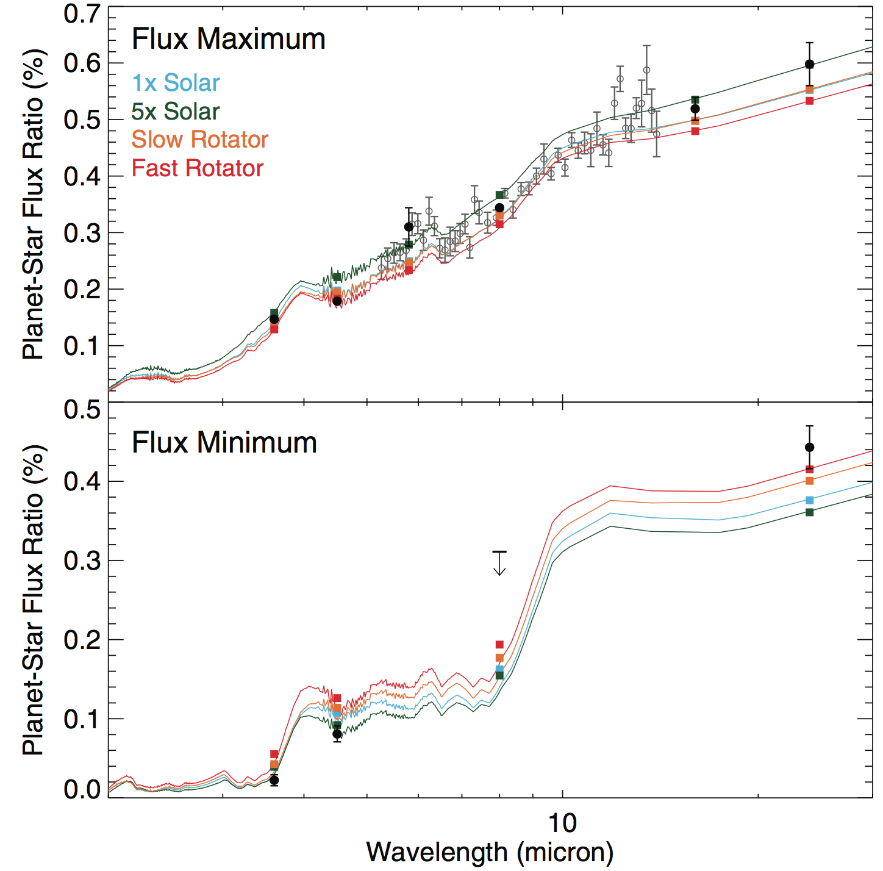
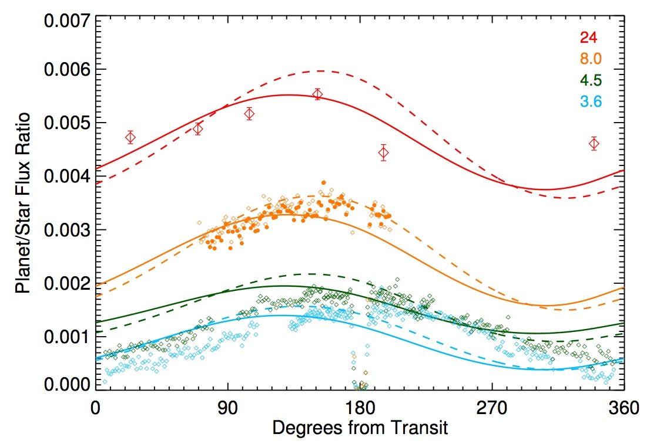
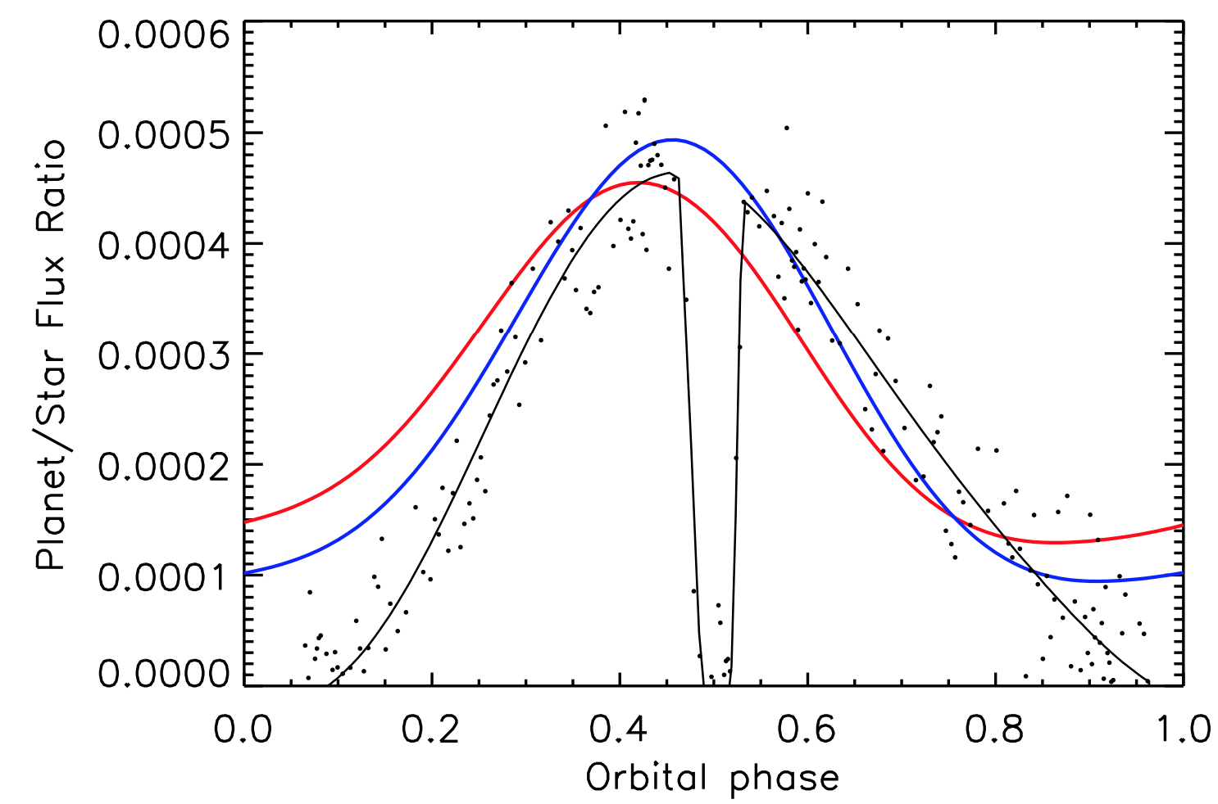
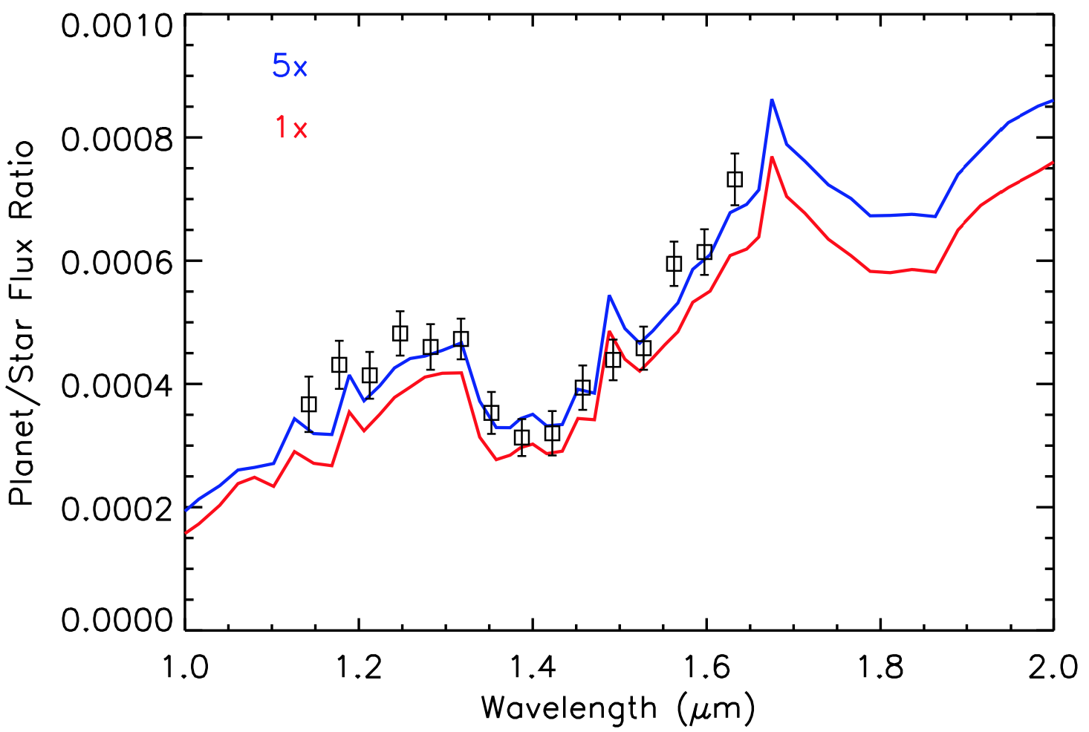
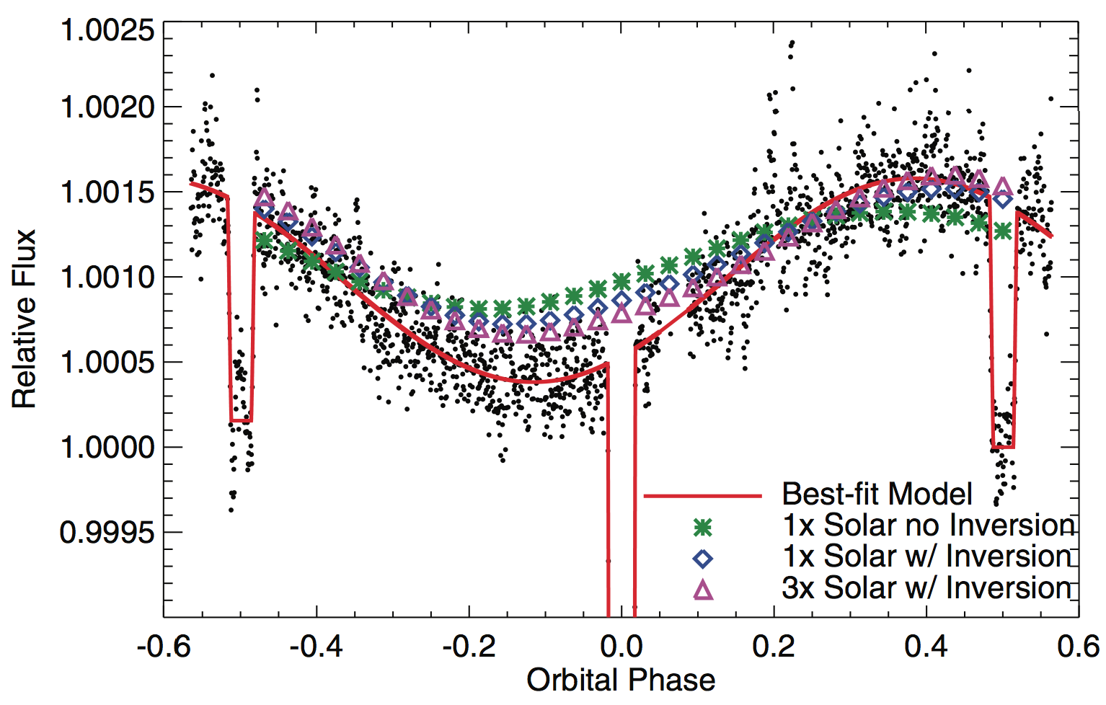
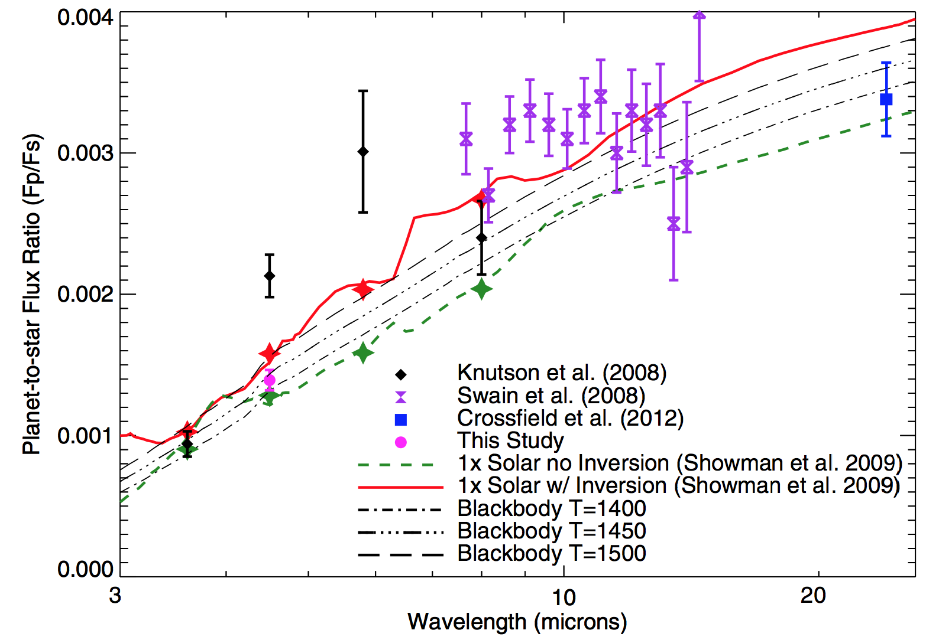
Comparisons of data to GCMs
Showman et al. (2009), Knutson et al. (2012)
HD 189733b
WASP-43b
Kataria et al. (2015)
HD 209458b
Showman et al. (2009), Zellem et al. (2014)

Slide 11
What causes the equatorial superrotation?
Hide’s theorem: Superrotating equatorial jets (corresponding to local maxima of angular momentum) cannot result from axisymmetric circulations (e.g., angular-momentum conserving Hadley cells).
Such jets must instead result from up-gradient momentum transport by waves and/or turbulence
This is a fairly common phenomenon in turbulence… the question is, in the present context, what is the specific mechanism?

Slide 12
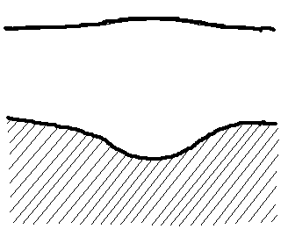
Simple models to isolate superrotation mechanism
To capture the mechanism in the simplest possible context, adopt the shallow-water equations for a single fluid layer:
where (h_{eq}-h)/τ_{rad} represents thermal forcing/damping, −v/τ_{drag} represents drag, and where δ=1 when Q_{h}>0 and δ=0 otherwise
First consider linear, steady analytic solutions and then consider full nonlinear solutions on a sphere.
Radiatively active atmosphere
h
Deep atmosphere and interior

Slide 13
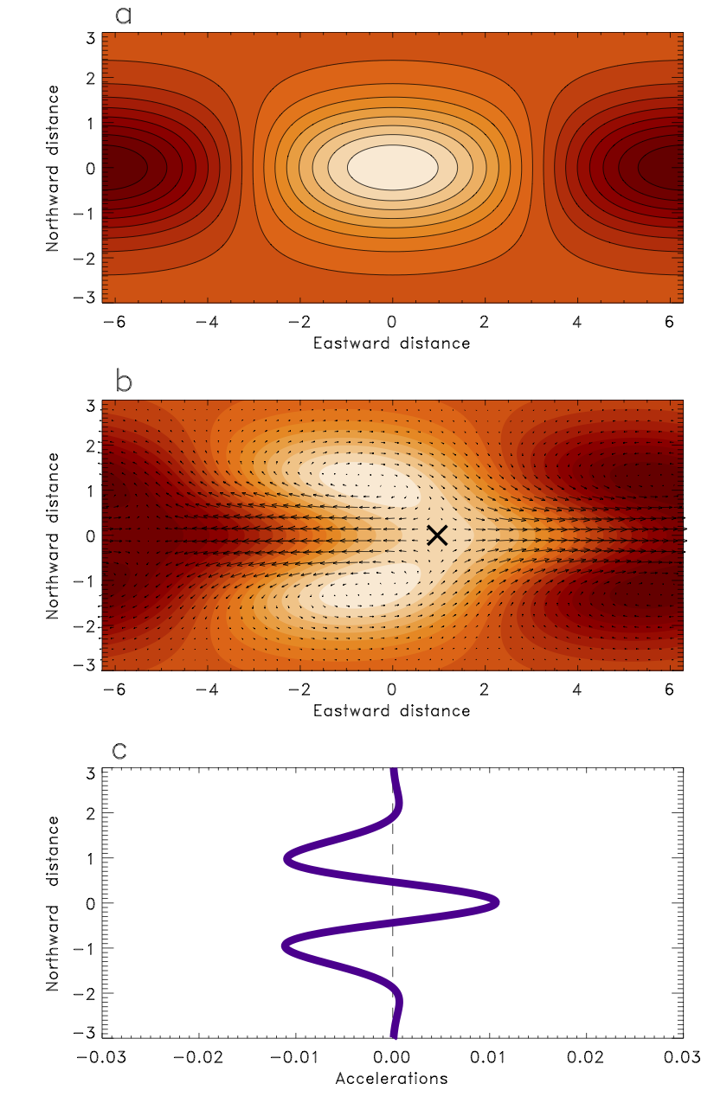
Linear analytic calculation
The day/night thermal forcing induces standing planetary-scale (Rossby and Kelvin) waves, which transport momentum to the equator. This induces superrotation.
Showman & Polvani (2011), ApJ 738, 71

Slide 14
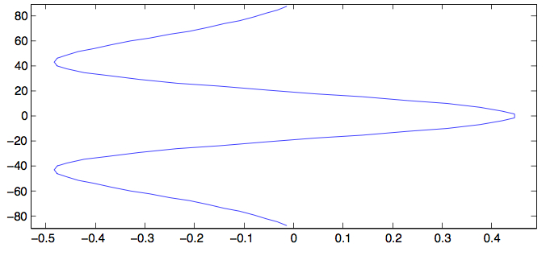
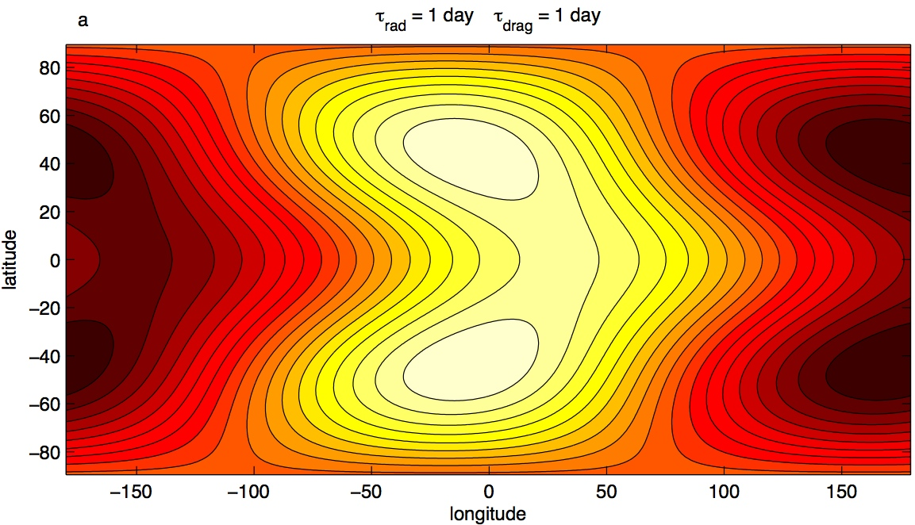
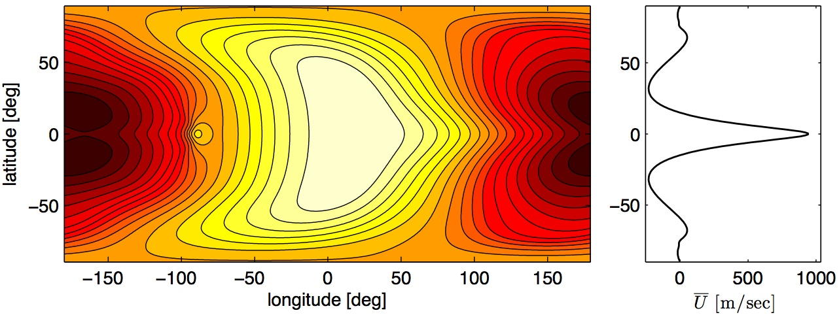
Full nonlinear numerical solutions on a sphere
Low amplitude (~linear)
High amplitude (non-linear)
Showman & Polvani (2011)

Slide 15
This Rossby/Kelvin wave pattern is clearly evident in spin-up phase of 3D hot Jupiter simulations
Showman & Polvani (2011)

Slide 16
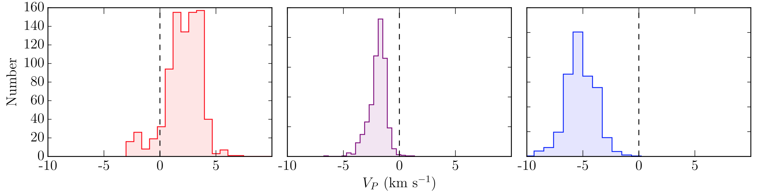
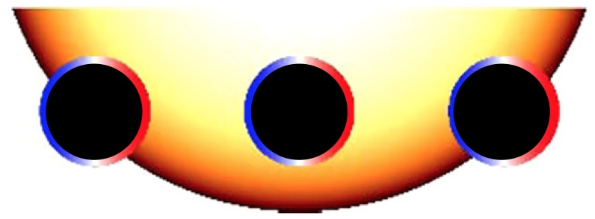
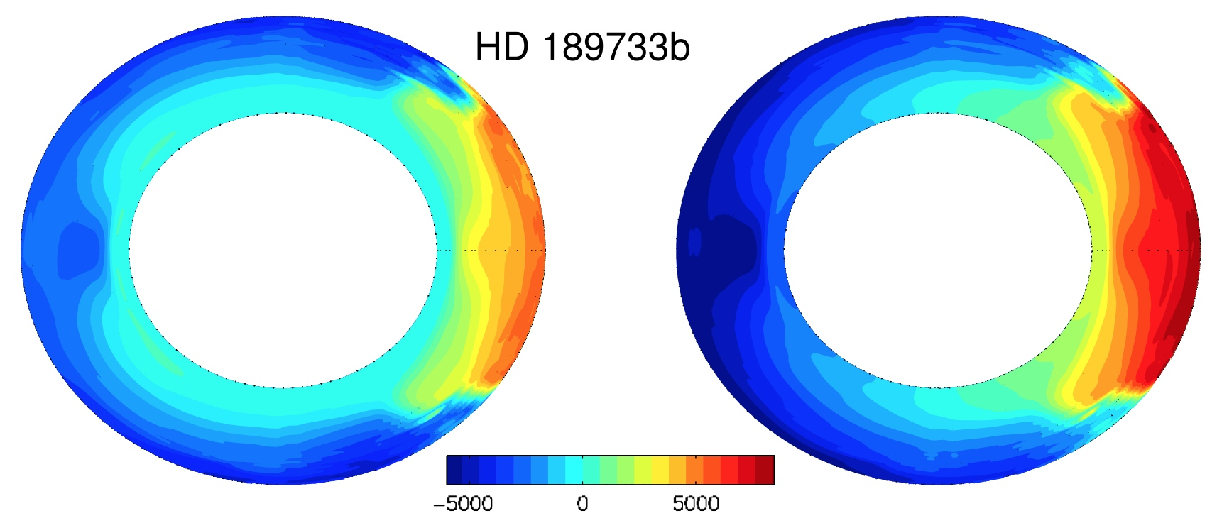
Doppler detection of equatorial jet
A direct detection of the equatorial jet has recently been made, and is consistent with GCM predictions.
Louden & Wheatley (2015)
Leading limb
Average during transit
Trailing limb
Showman et al. (2013)

Slide 17
Toward predictive theories of the circulation
GCM simulations are useful but by themselves do not imply understanding
The ultimate goal is to understand the mechanisms and obtain a predictive theory for the day-night temperature differences, vertical mixing rates, and other aspects of the circulation.
It is commonly assumed that day-night temperature differences are small if τ_{rad} >> τ_{advect} and temperature differences are large if τ_{rad} << τ_{advect} .
Problems: This is not predictive, since τ_{advect} depends on the flow. It also neglects a role for other important timescales in the problem, including wave, frictional, and rotational timescales. These almost certainly matter.

Slide 18
Weak damping (τ_{rad} = 10 days), relevant to cool planets
From Warm to
Very Hot Jupiters
Moderate damping (τ_{rad} = 1 day), relevant to warm planets
Strong damping (τ_{rad} = 0.1 days), relevant to hot planets
Showman et al. (2013)

Slide 19
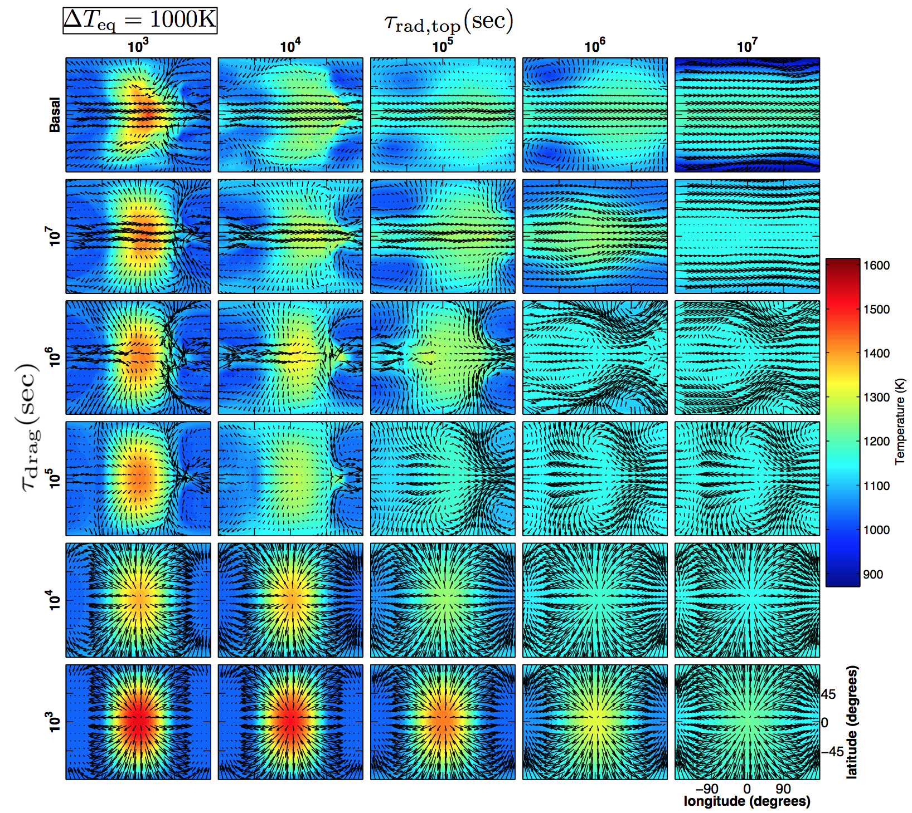
Hot-Jupiter circulation in idealized GCM simulations as a function of radiative time constant and strength of frictional drag
Komacek & Showman (2016); see also Perez-Becker & Showman (2013)

Slide 20
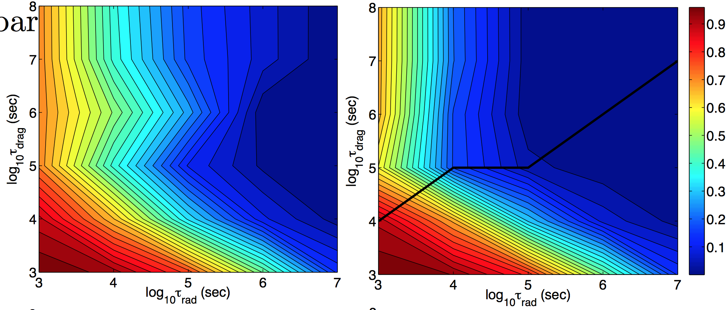

Theory for day-night temperature contrast
Day-night thermal contrast from three-dimensional GCM simulations
Day-night thermal contrast from a fully predictive theory with zero free parameters and no tuning
Komacek & Showman (2016); see also Perez-Becker & Showman (2013)
The theory matches the simulation results well over a multi-order-of-magnitude parameter space in the radiative and frictional time constants.
The theory shows that the transition between regimes is generally controlled by wave adjustment (and the resulting vertical advection) rather than horizontal advection timescales.

Slide 21
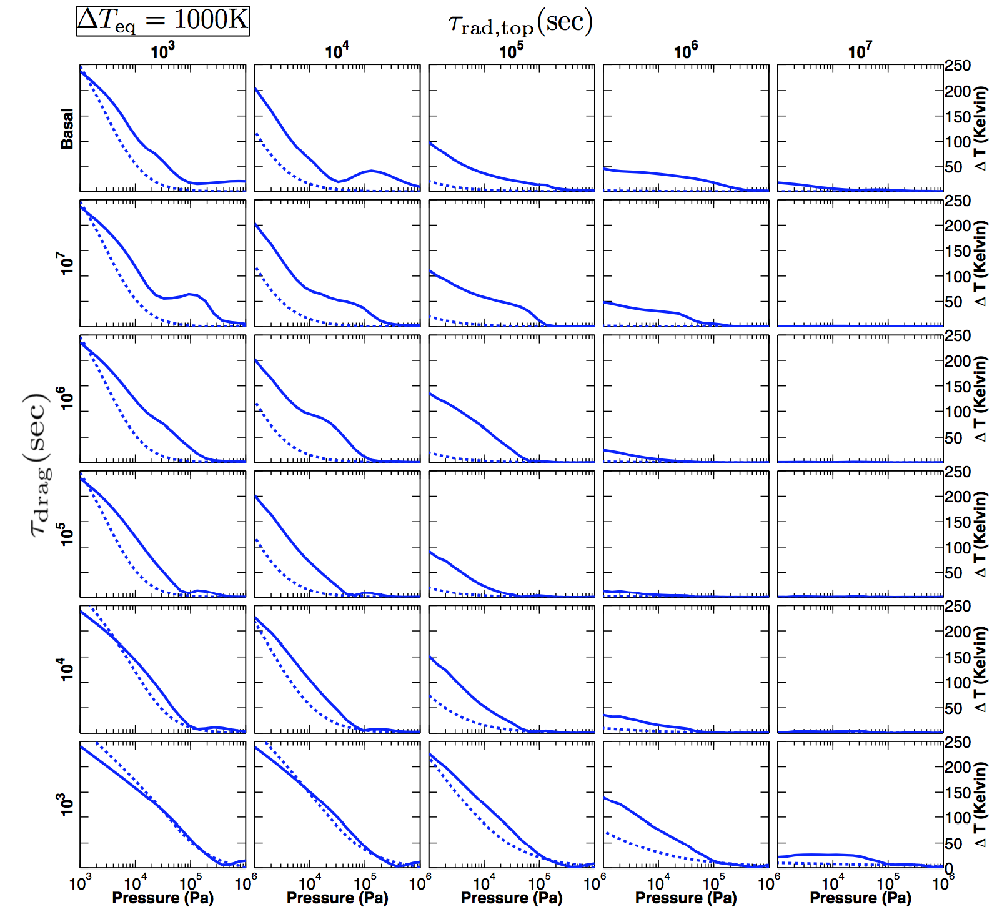
Day-night temperature differences vs pressure
Curves:
Solid=GCM Dotted=theory
Komacek & Showman (2016)

Slide 22

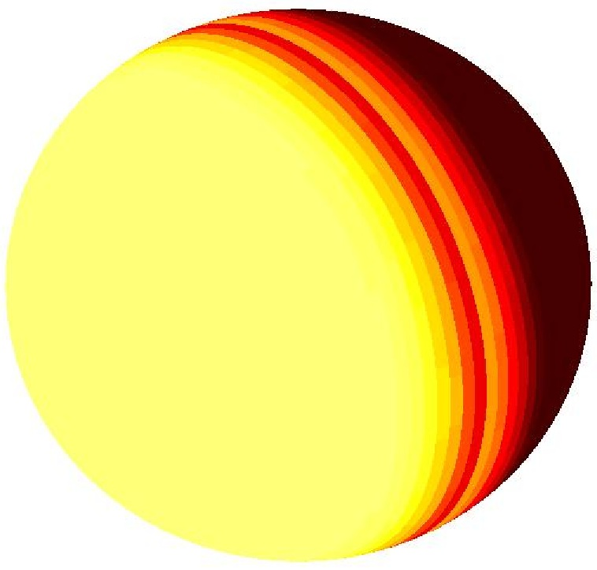
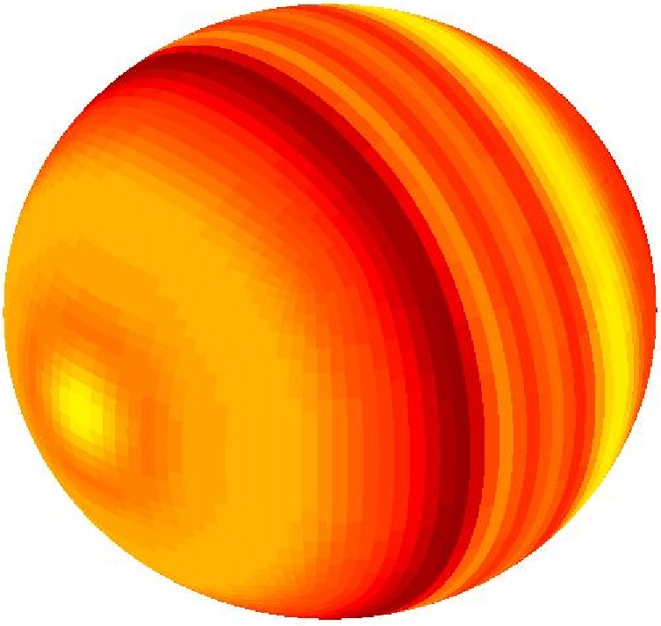
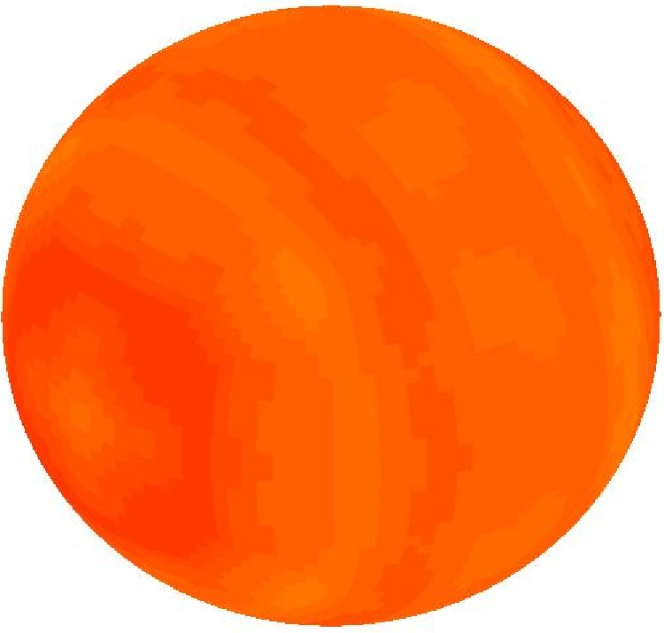
Wave adjustment process
Waves adjust isentropes up or down in an attempt to flatten them. This erases horizontal temperature differences.
Showman et al. (2013b), “Atmospheric circulation of terrestrial exoplanets,” submitted to Comparative Climatology of TerrestrialPlanets, Univ. Arizona Press (to be published)
This is a key mechanism for maintaining the small longitudinal temperature differences in Earth’s tropics: the “weak temperature gradient” or WTG regime.

Slide 23
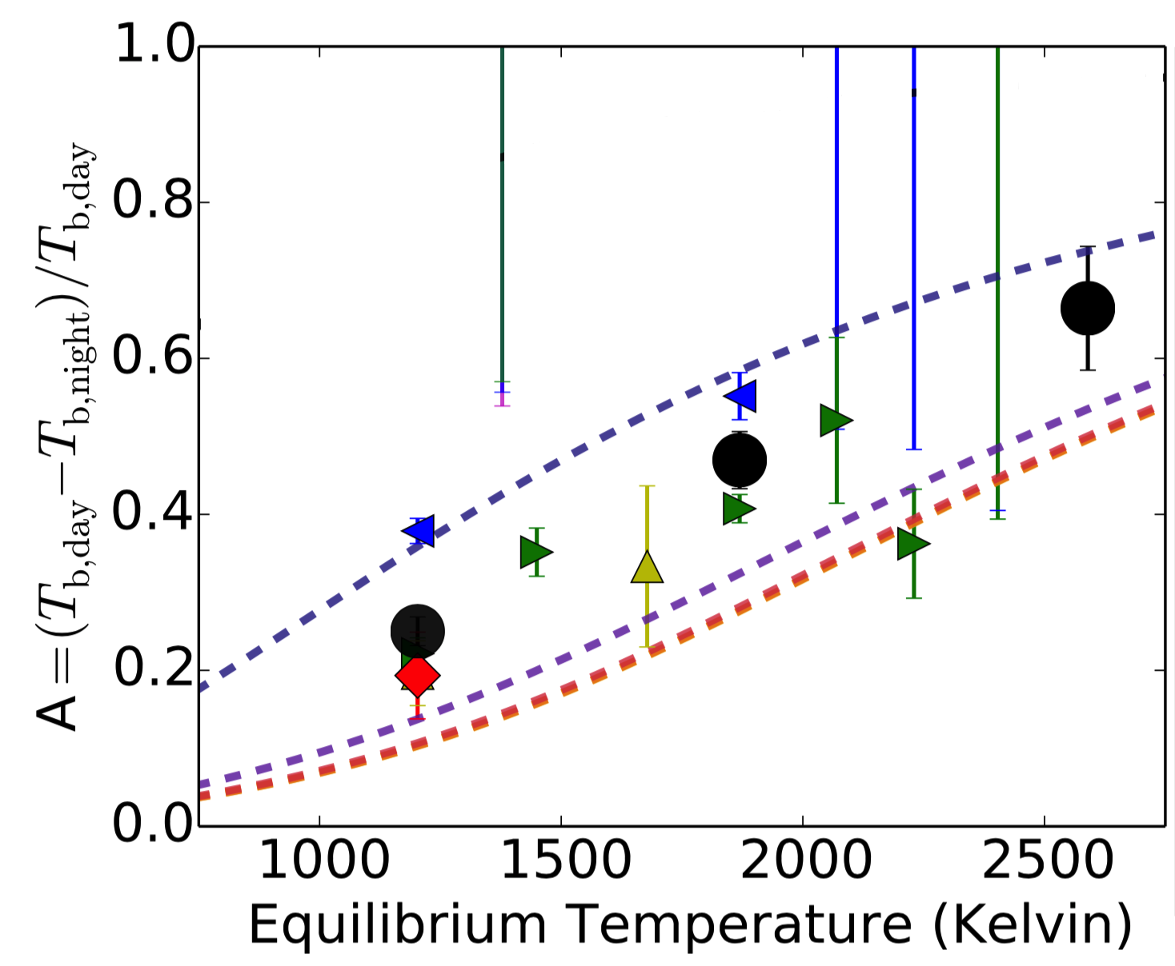
The model explains the emerging observational trend
Komacek & Showman (2016), Perez-Becker & Showman (2013)

Slide 24
What about objects cooler than “classical” hot Jupiters?
Despite the focus on hot Jupiters, known EGPs populate a continuum from ~0.03-0.05 AU to > 1 AU
Such “warm” Jupiters will rotate non-synchronously:
Fundamental questions also exist about how the circulation on hot Jupiters relates to that on Jupiter, Earth, and brown dwarfs
All of this motivates an investigation of how hot Jupiter circulation regimes--and observables--vary with incident stellar flux and rotation rate

Slide 25
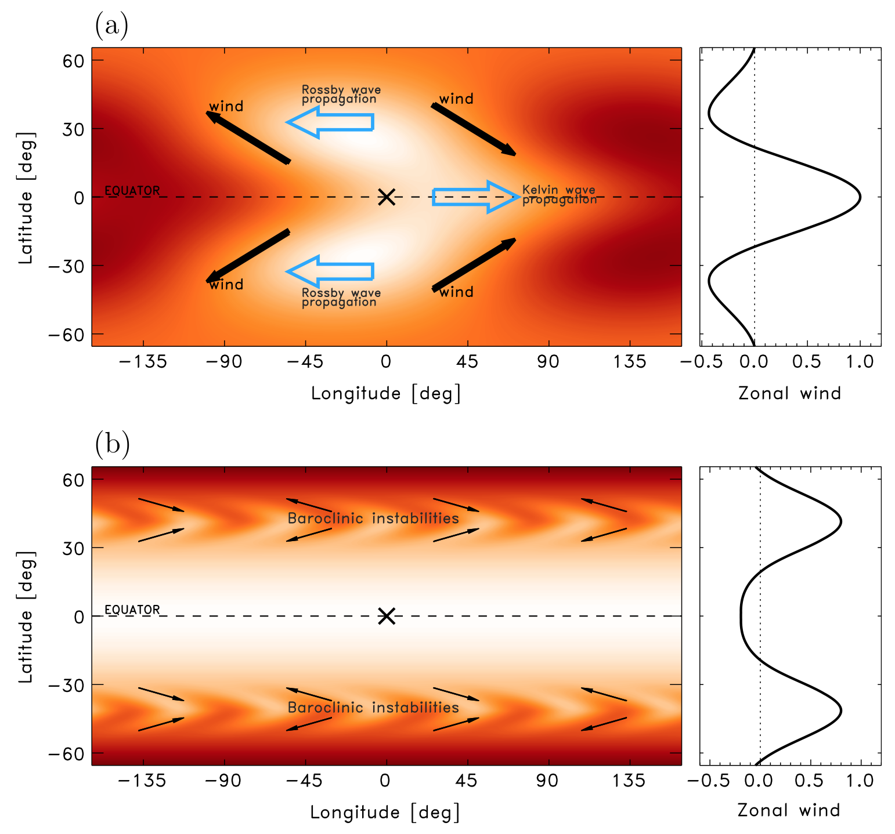
A regime shift from hot to warm Jupiters?

Slide 26
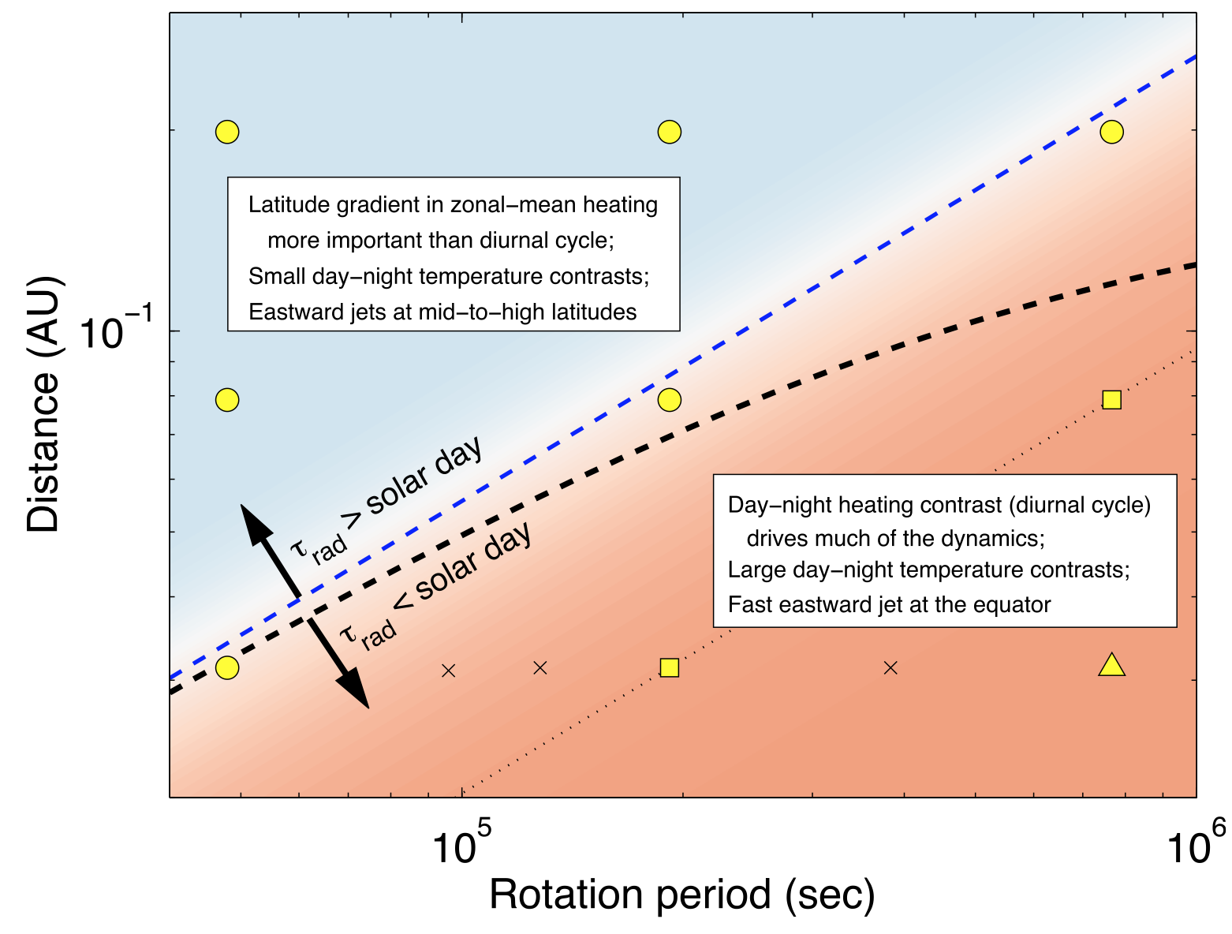
Predicted regimes
0.2 AU
0.03 AU
0.5 day
8.8 day

Slide 27
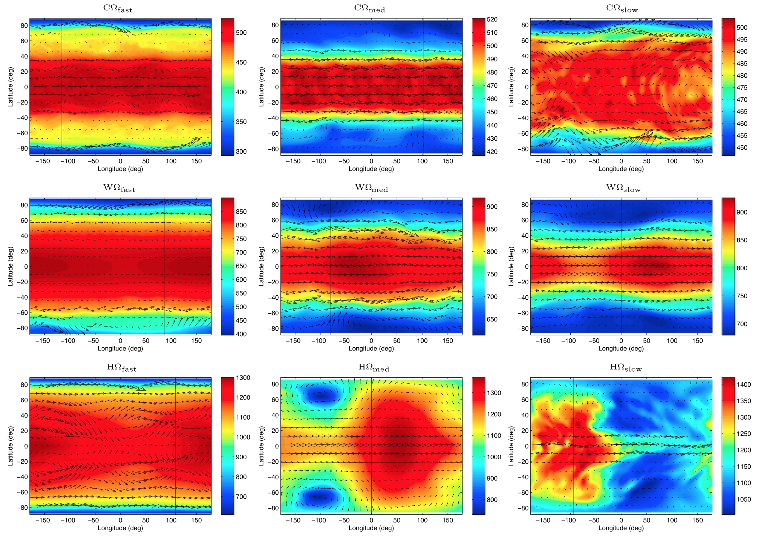
Showman, Lewis & Fortney (2015)
0.2 AU
Orbital distance
0.03 AU
0.5 day
Rotation period
8.8 day

Slide 28
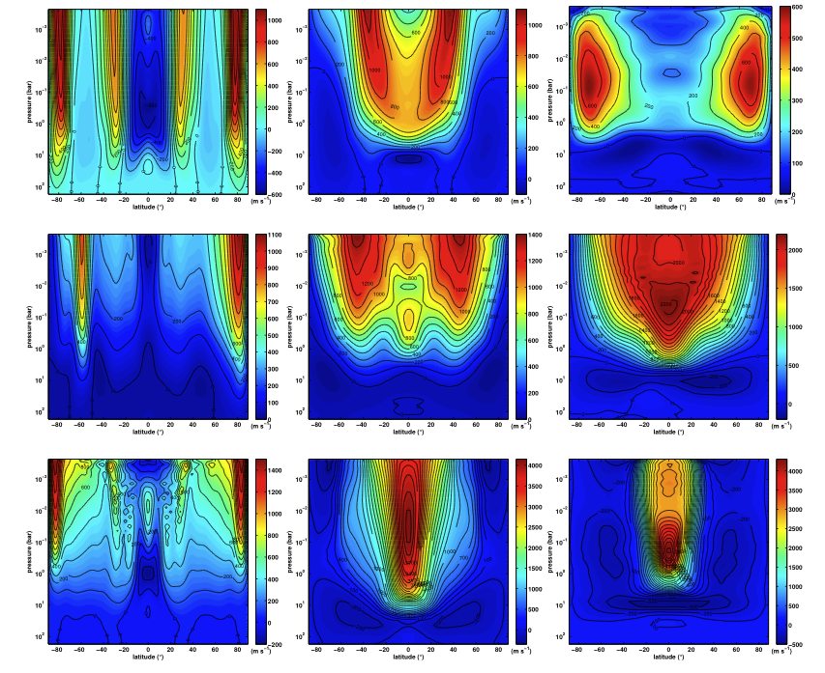
0.2 AU
Showman, Lewis, & Fortney (2015)
Orbital distance
0.03 AU
0.5 day
Rotation period
8.8 day

Slide 29
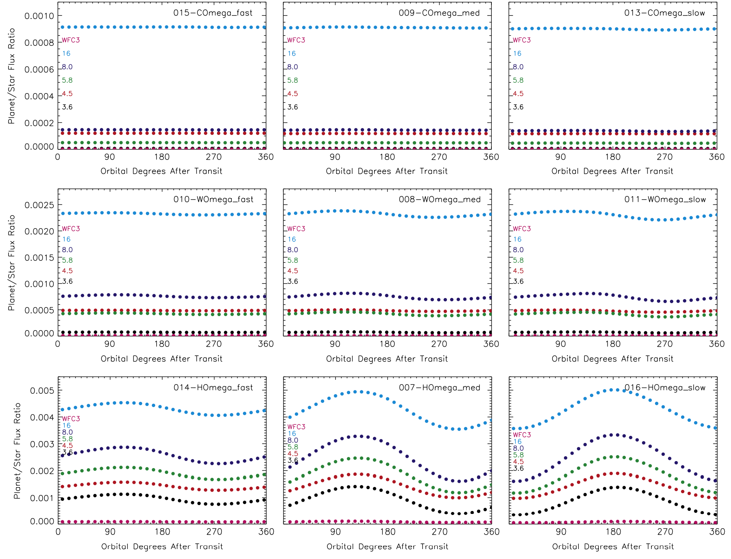
Observational predictions: IR light curves
0.2 AU
Showman, Lewis, & Fortney (2015)
Orbital distance
0.03 AU
0.5 day
Rotation period
8.8 day

Slide 30
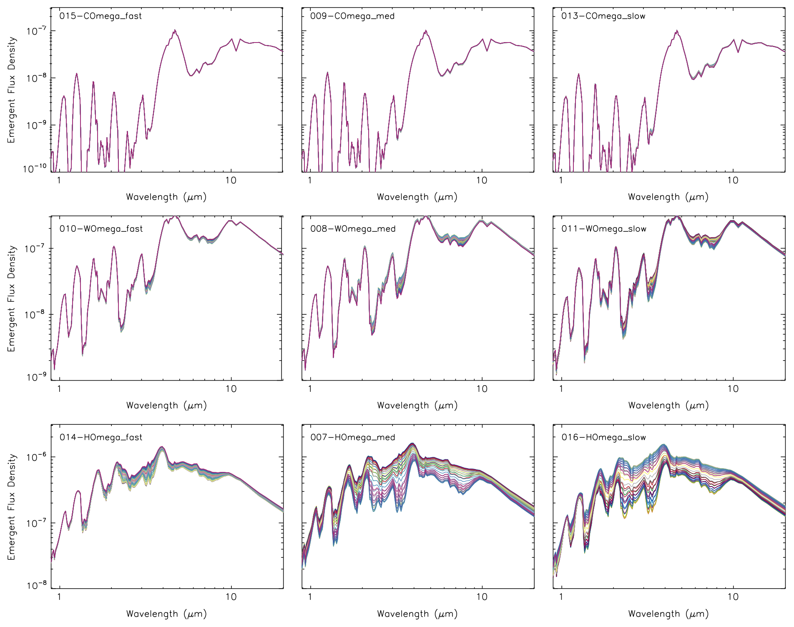
Observational predictions: IR spectra
0.2 AU
Showman, Lewis, & Fortney (2015)
Orbital distance
0.03 AU
0.5 day
Rotation period
8.8 day

Slide 31
Dynamical themes
The typical hot Jupiter is in the “all tropics” regime where equatorial (e.g., Kelvin and Rossby) waves adjust the temperature structure in the longitude direction, and meridional (“Hadley”) circulations adjust it in latitude.
Breakdown of the wave adjustment allows large day-night temperature differences on particularly close-in hot Jupiters.
Standing equatorial (Kelvin and Rossby) waves triggered by the day-night thermal forcing transport momentum to the equator, causing equatorial superrotation.
Rapidly rotating EGPs will have both tropics and an extratropics, with heat transport at high latitudes controlled by baroclinic instabilities, with large equator-pole temperature differences and zonal-mean winds peaking in midlatitudes. Lightcurves may allow constraints on rotation rates for non-synchronously rotating planets.

Slide 33
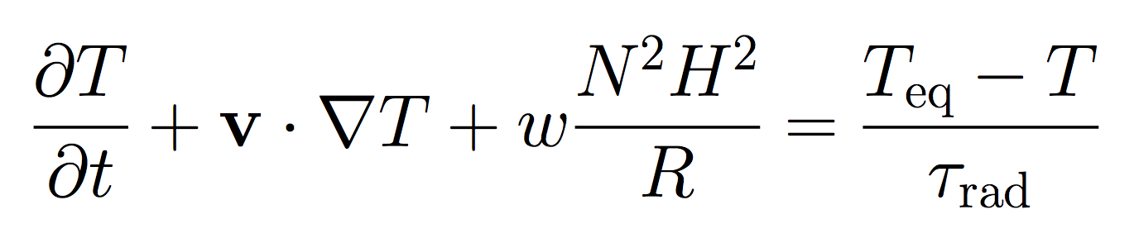
Approach to constructing a theory
Thermodynamic energy equation:

Slide 34
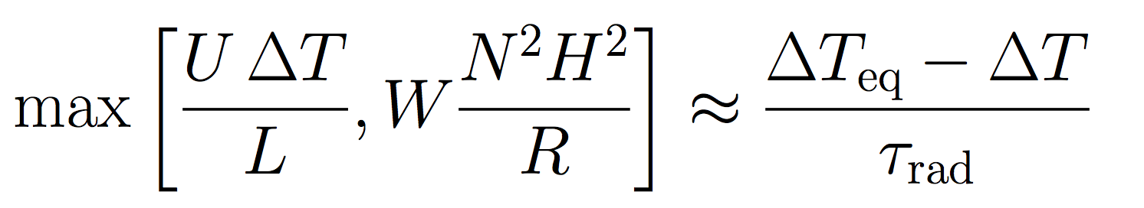
Approach to constructing a theory
Thermodynamic energy equation:
Here, variables are:
ΔT=day-night temperature difference
U=horizontal wind speed
W=vertical wind speed
Goal: solve analytically for ΔT, U, and W as a function of control parameters (τ_{rad}, τ_{drag}, rotation rate, planetary radius, etc)

Slide 35
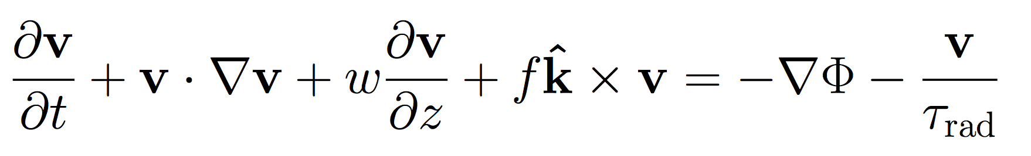

Approach to constructing a theory
Thermodynamic energy equation:
Here, variables are:
ΔT=day-night temperature difference
U=horizontal wind speed
W=vertical wind speed
Momentum equation:
Goal: solve analytically for ΔT, U, and W as a function of control parameters (τ_{rad}, τ_{drag}, rotation rate, planetary radius, etc)

Slide 36
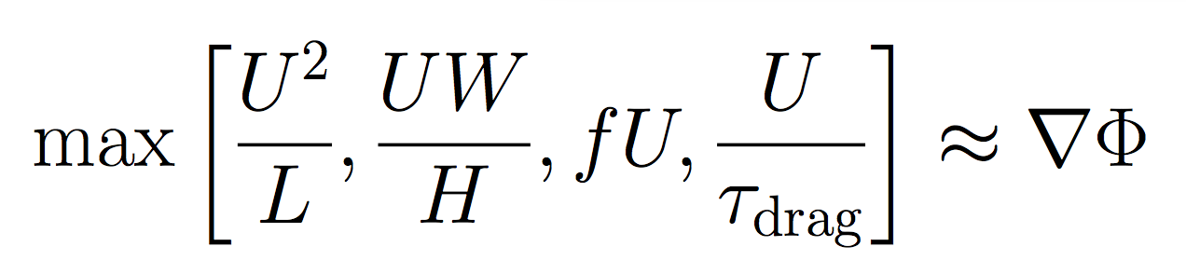
Approach to constructing a theory
Thermodynamic energy equation:
Here, variables are:
ΔT=day-night temperature difference
U=horizontal wind speed
W=vertical wind speed
Momentum equation:
Goal: solve analytically for ΔT, U, and W as a function of control parameters (τ_{rad}, τ_{drag}, rotation rate, planetary radius, etc)

Slide 37
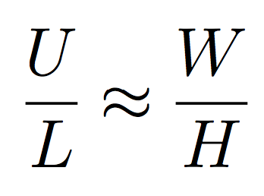
Approach to constructing a theory
Thermodynamic energy equation:
Here, variables are:
ΔT=day-night temperature difference
U=horizontal wind speed
W=vertical wind speed
Momentum equation:
Continuity equation:
Goal: solve analytically for ΔT, U, and W as a function of control parameters (τ_{rad}, τ_{drag}, rotation rate, planetary radius, etc)

